Slide 1

Fundamentals of Onshore Drilling
Basics of Rotary Drilling
Rotary Operations / Coring
presentation No. 2
references:
Bernt S. Aadnoy, Iain Cooper, Stefan Z. Miska, Robert F. Mitchell, Michael L. Payne: Advanced Drilling and Well Technology. SPE 2009, ISBN: 978-1-55563-145-1.
Robello G. Samuel, Xiushan Liu: Advanced Drilling Engineering – Principles and Design. Gulf Publishing Company, Houston Texas, 2009,
ISBN: 978-1-933762-34-0.
World Oil´s Handbook of Horizontal Drilling and Completion Technology.
Gulf Publishing Company, Houston, Texas 1991, ISBN 0-87201-361-8.
A Primer of Oilwell Drilling. Petroleum Extension Service, Houston, Texas 2001, ISBN: 0-88698-194-8.
Robello, R. G.: Downhole Drilling Tools. Gulf Publishing Company, Houston, Texas
2007, ISBN: 978-1933762135.
2010 Drill Bit Classifier. World Oil September 2010.
Casing References Tables 2012. World Oil January 2012.

Slide 2
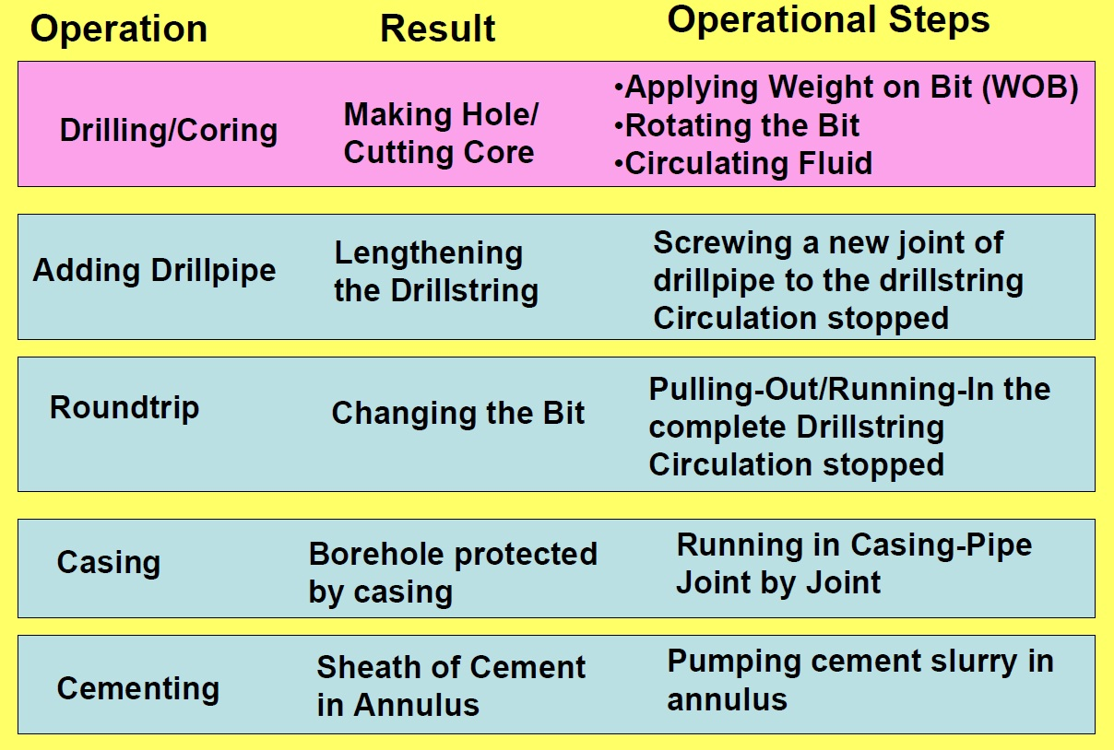
Major Rotary Operations

Slide 3
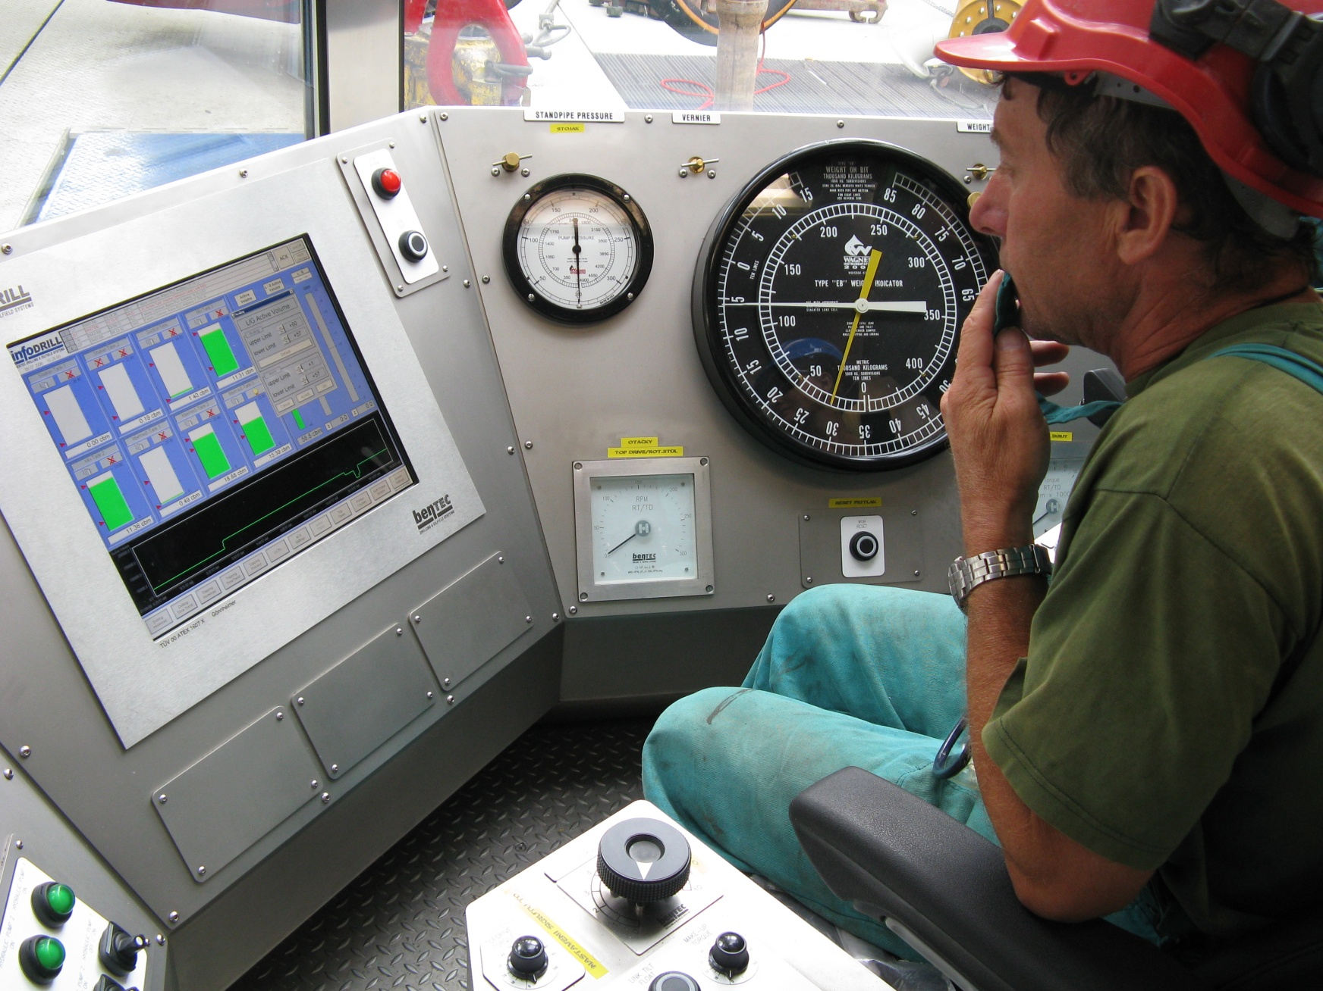
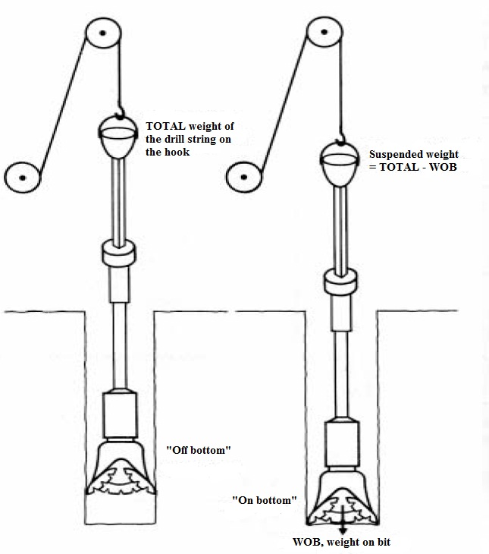
Major Rotary Operations - Drilling

Slide 4
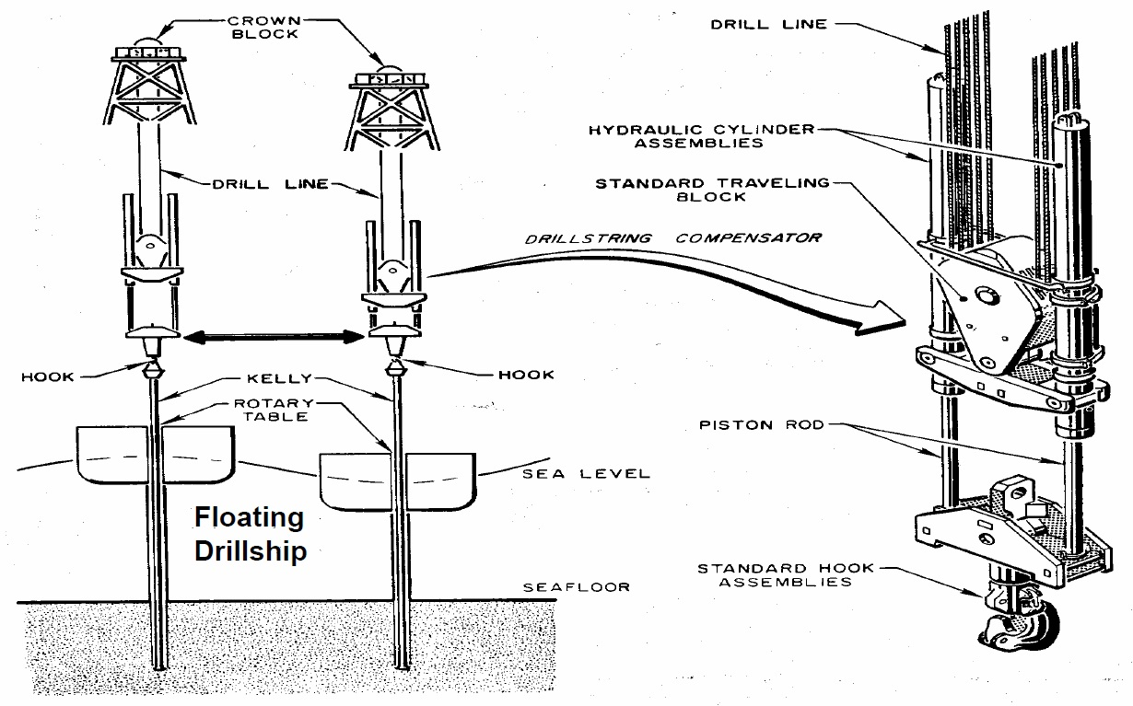
Controlling WOB with a Heave Compensation System

Slide 5
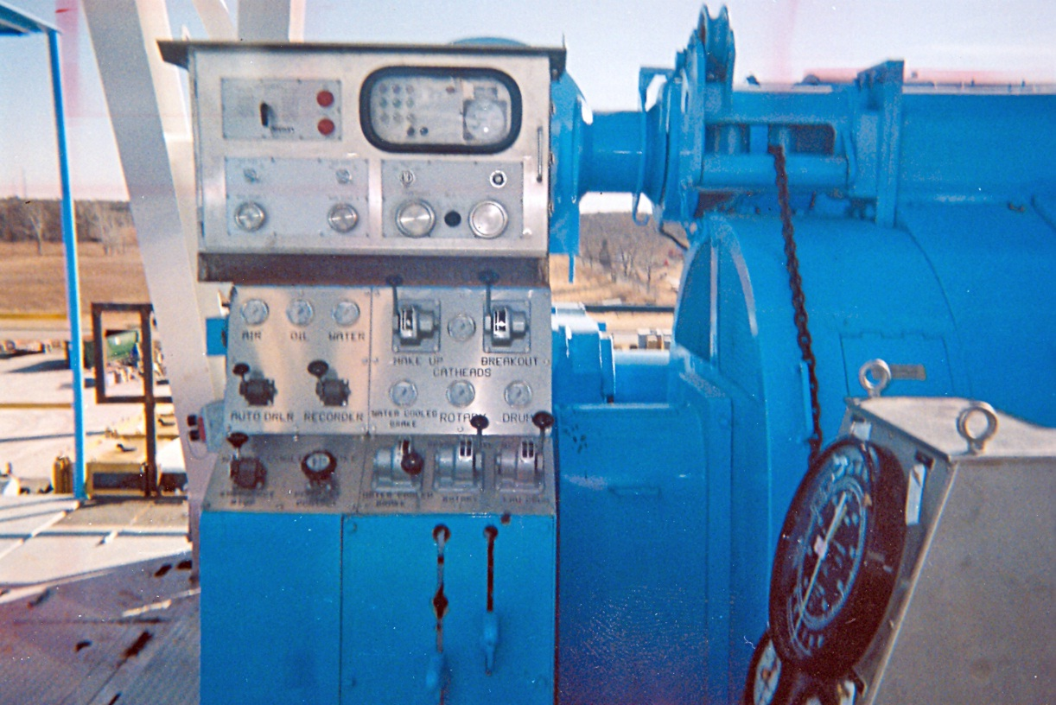
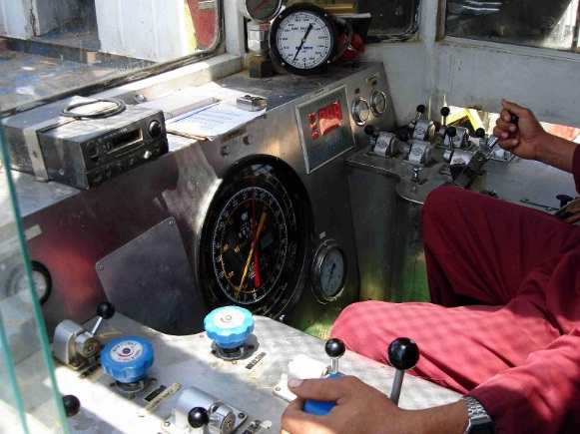
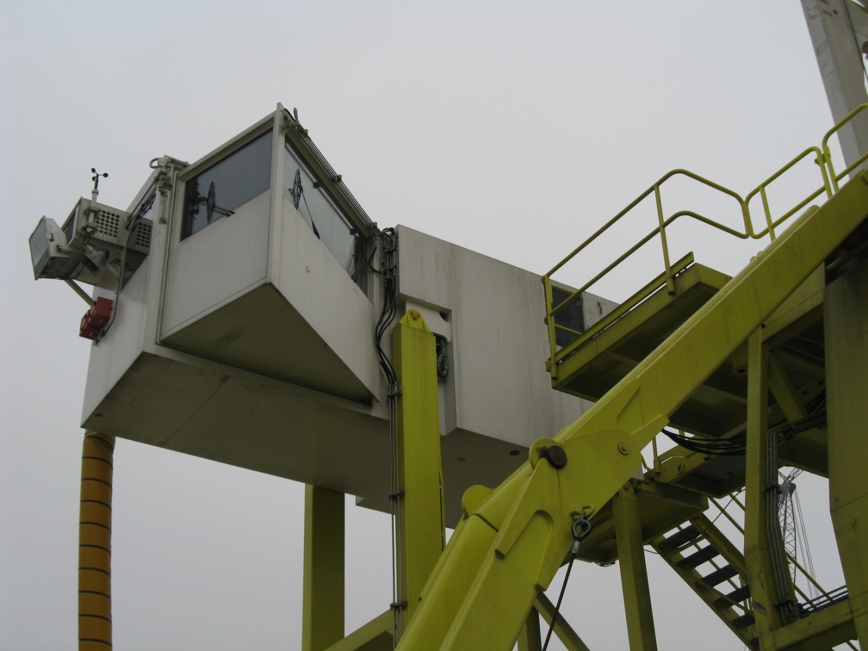
Drillers Console

Slide 6
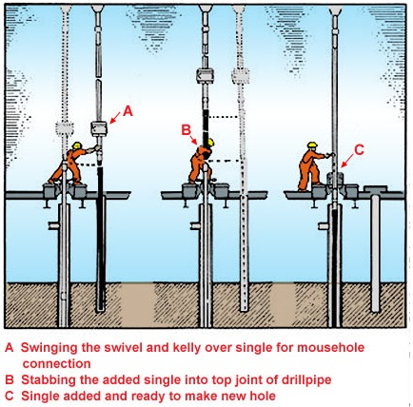
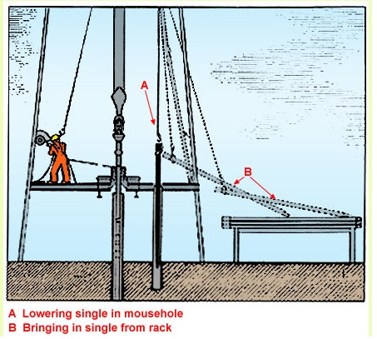
Major Rotary Operations – Adding Drillpipe

Slide 7
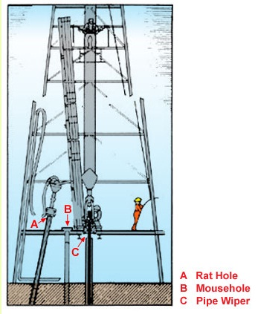
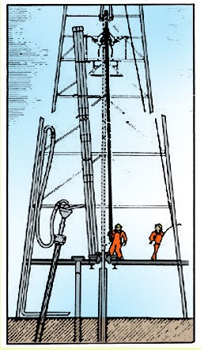
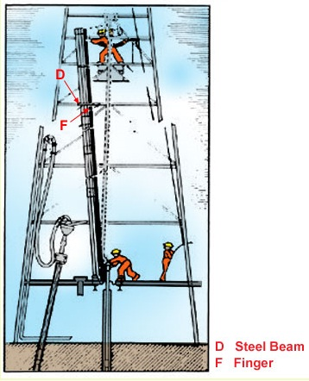
Major Rotary Operations – Adding Drillpipe

Slide 8
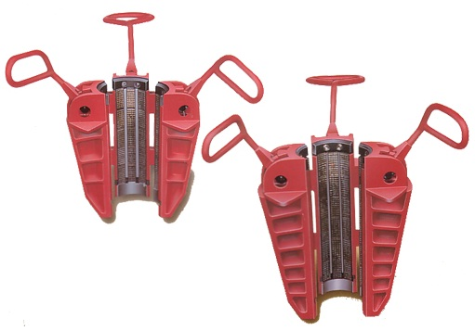
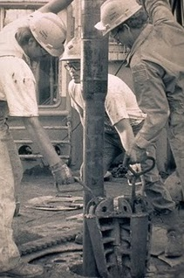
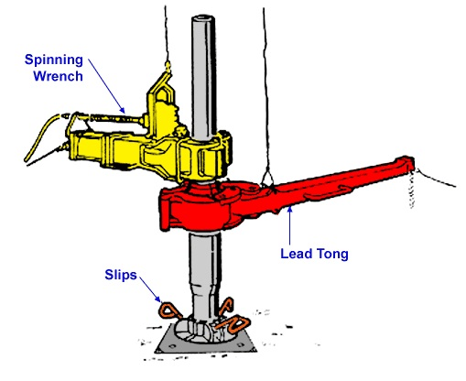
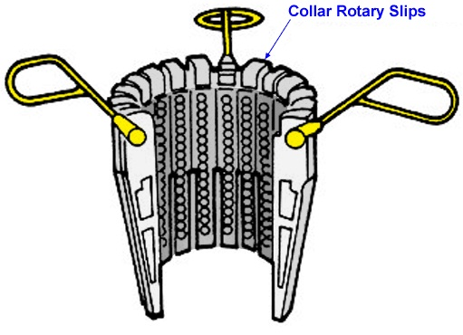
Suspending the Drill String in the Rotary Table by Slip

Slide 9
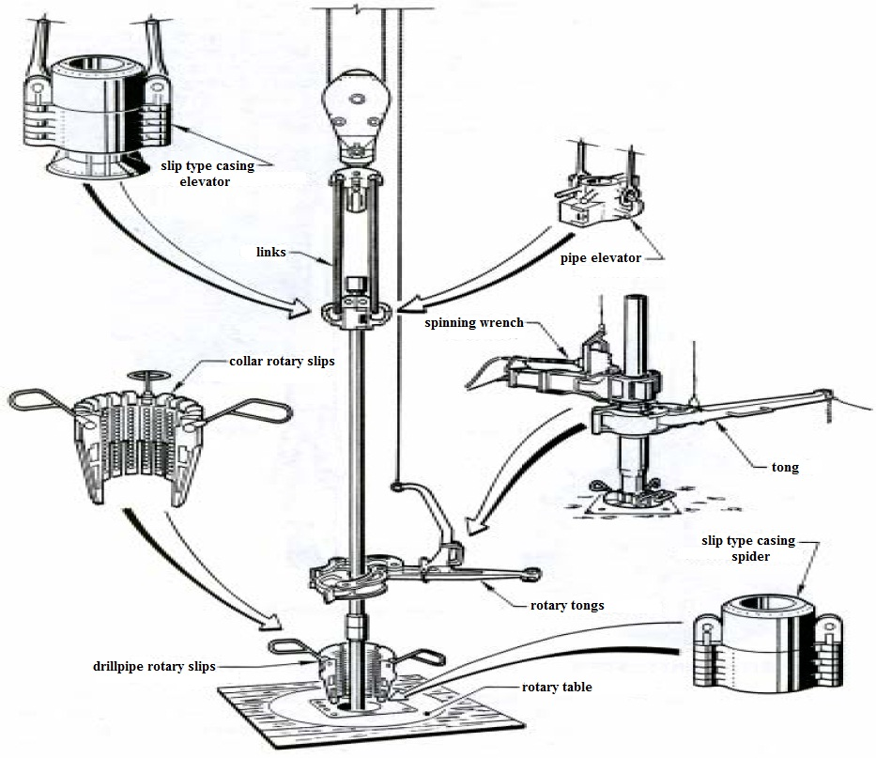
Rig Components used for Manual Pipe Handling

Slide 10
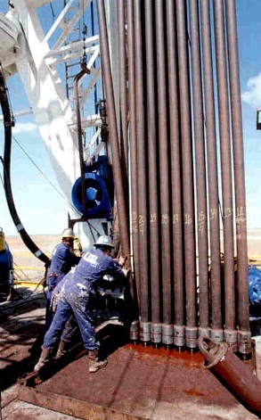
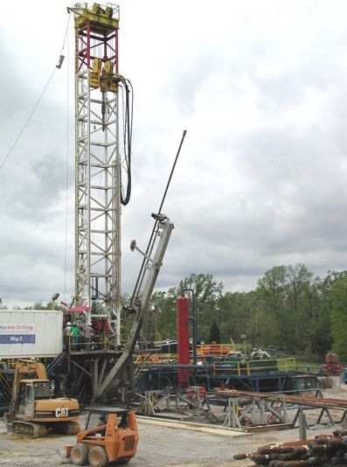
Roundtrip Operating
manually
with pipe handling system

Slide 11
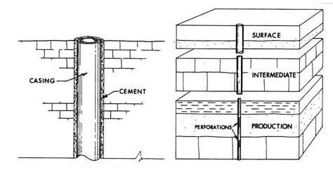
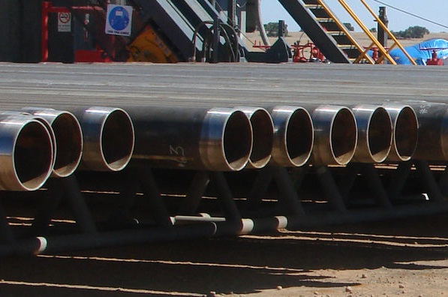
Reasons for Casing the Hole
Casing is a string of single steel pipes with lenght of 8 – 16 m connected by threaded couplings
Casing is specified by
outer diameter of casing pipe
weight per foot (wall thickness)
grade of steel
type of coupling

Slide 12
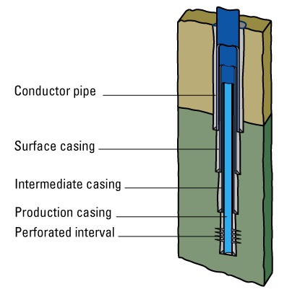
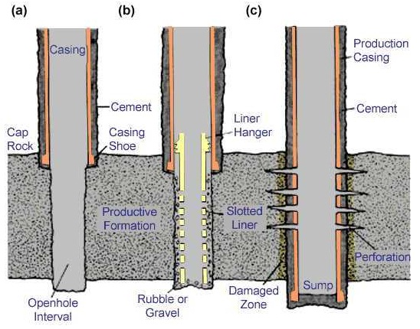
Planning Rules for Drilling and Casing Program
A good drilling and casing program is a decisive factor for technical and economical success of a drilling project.
Planning starts with the minimum borehole or casing diameter required at target depth.
Number of intermediate casing and depths of casing shoes are determined in dependency of the preliminary geological profile moving up progressively to surface.
Bit Diameters and Casing Diameters are standartized. They have to be selected according to given sizes.
Each casing set reduces the diameter that can be drilled through later on.

Slide 13
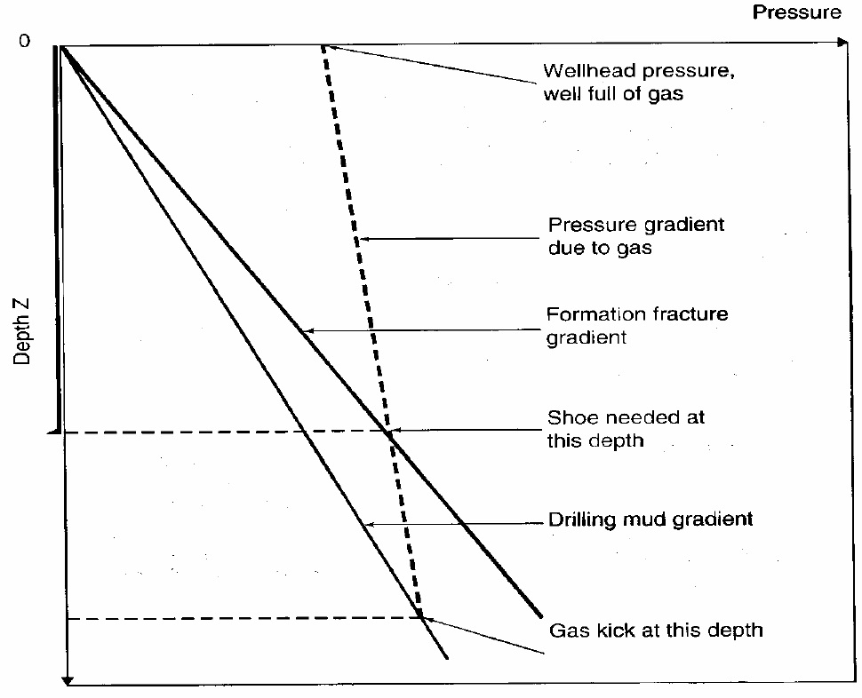
Pressure-Depth Diagram for Determination of Casing Shoe Depth

Slide 14
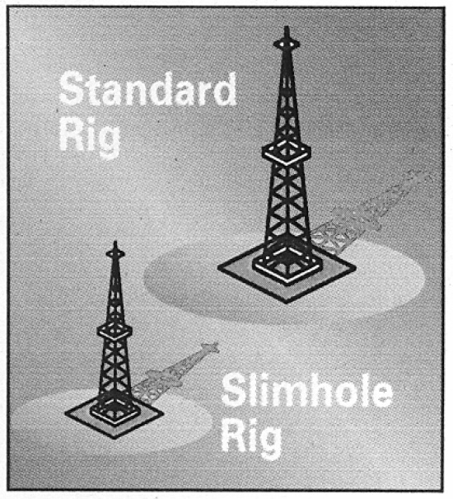
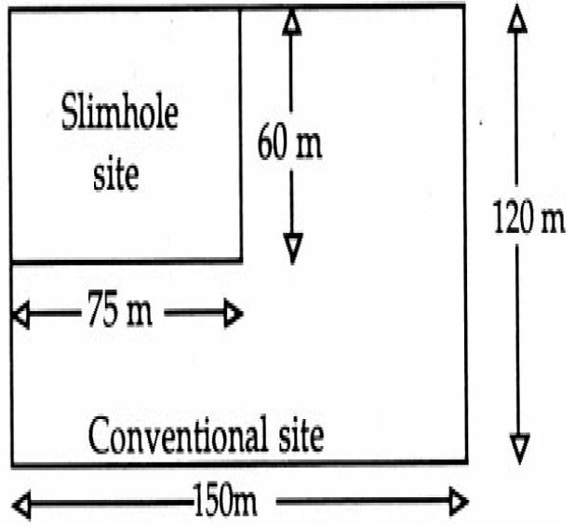
Benefits of Slim Hole Drilling
Benefits of Slim Hole Drilling:
hole diameters reduced by 50%
requires smaller rigs
site reduced by 75%
overall costs reduced by 40 – 50%

Slide 15
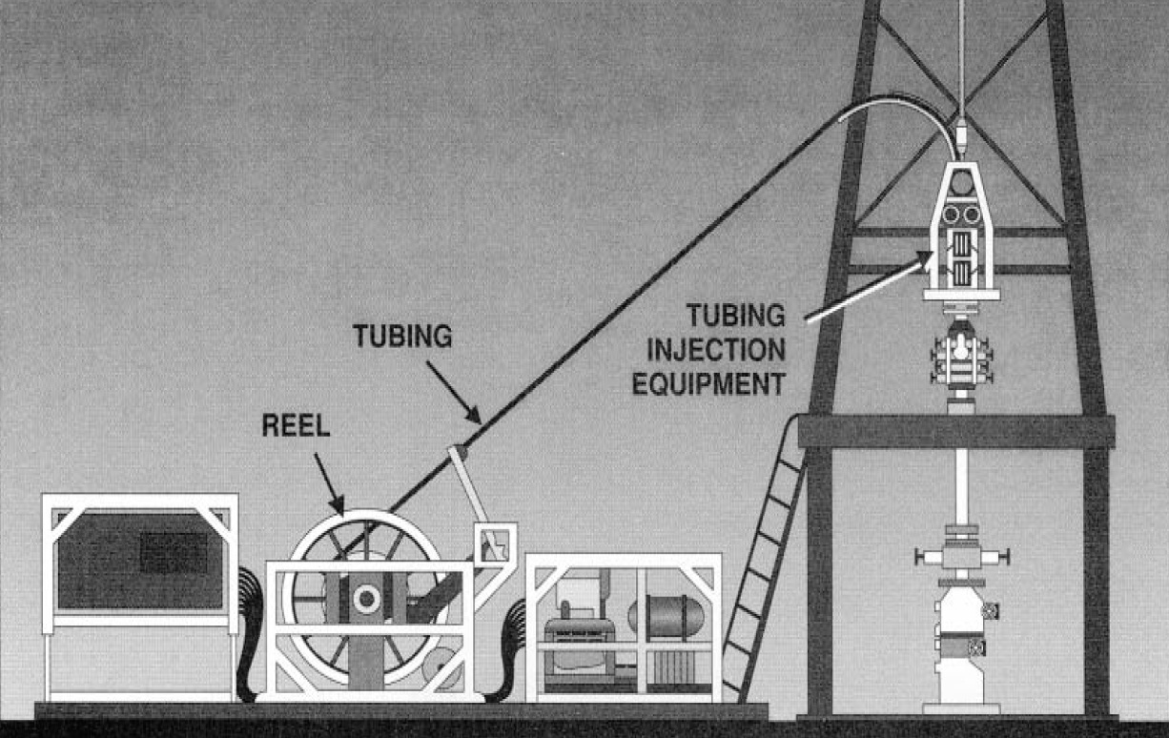
Slim Hole Drilling with Coiled Tubing Technology

Slide 16
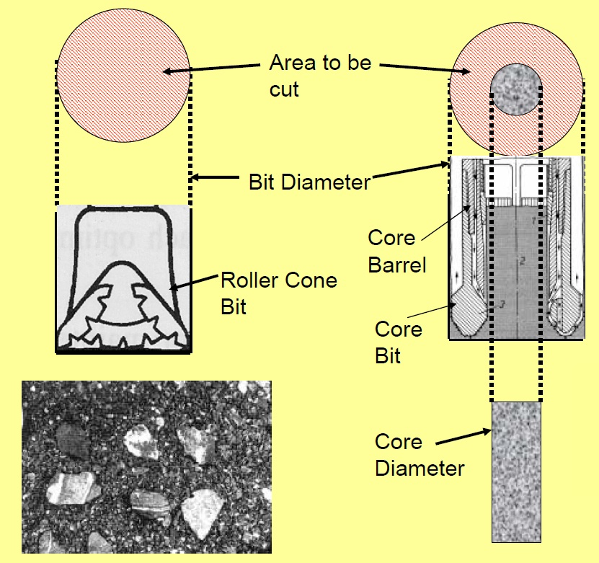
Principles of Core Drilling
Instead of cutting the total cross – sectional area only an annular ring or kerf of rock is cut leaving a solid cylinder of uncut formation passing into the core barrel above the bit.
Key Components:
Core Bit
Core Barrel
Retrieving Equipment

Slide 17
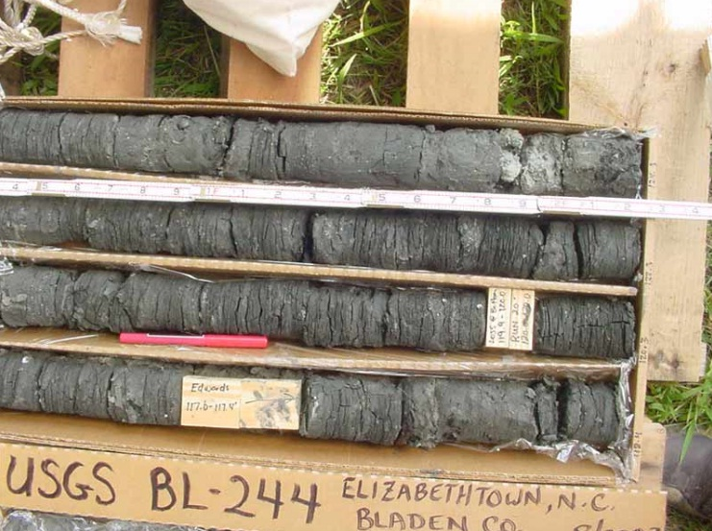
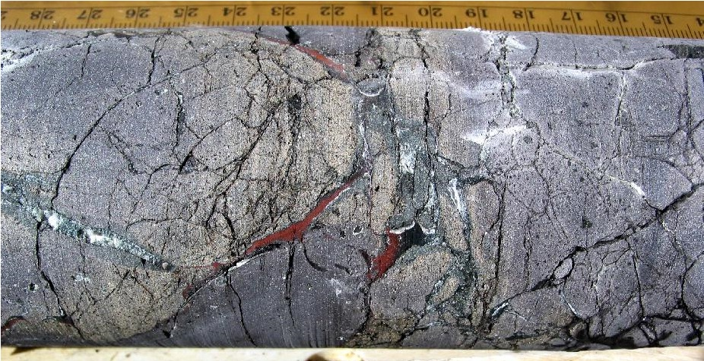
Reasons for Core Drilling
Coring is the only way to supply intact speciments of the formation anatomy
In Hard Rocks Core Drilling can be a very efficient way to make a hole at good penetration rates and low costs
Performance Parameter of Coring Operation:
Core Recovery (%) = Length of Core / Length of Core Run
Core Quality

Slide 18
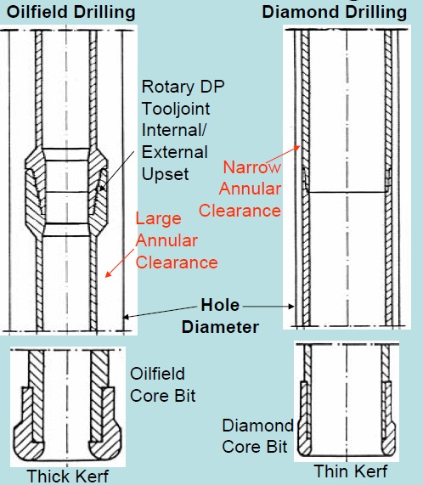
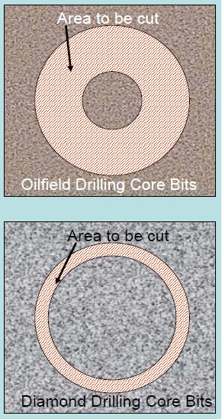
Core Drilling Techniques

Slide 19
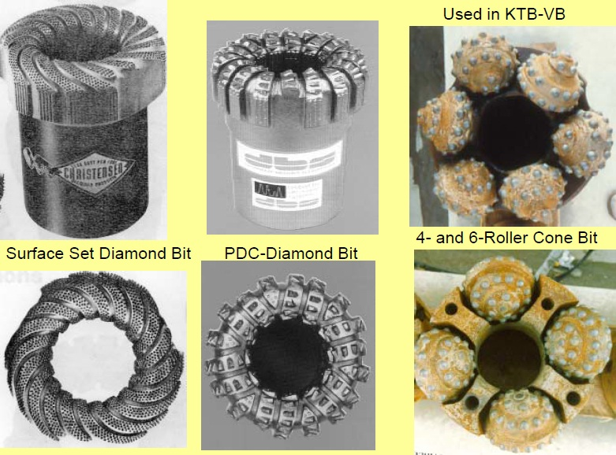
Types of Thick Kerfed Rotary Core Bits

Slide 20
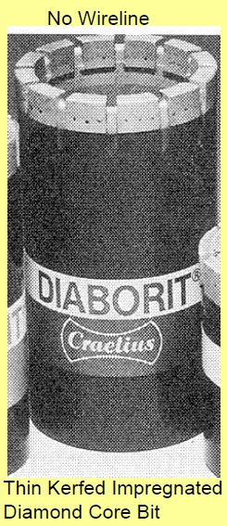
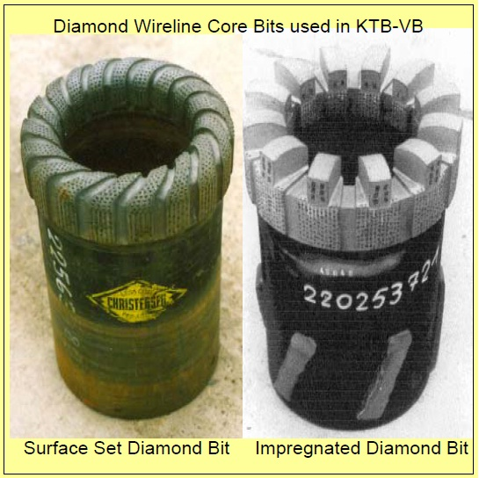
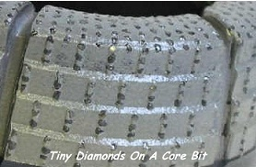
Types of Diamond Drilling Core Bits

Slide 21
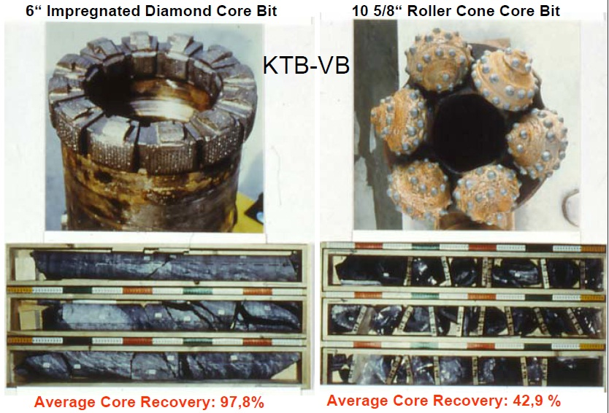
Performance of Core Bits in Crystalline Rock

Slide 22
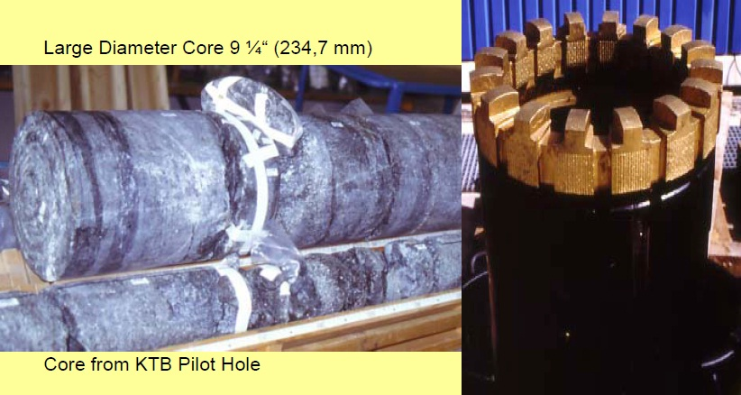
Large Diameter Diamond Coring in KTB Ultradeep Hole
12 ¼” Hole Section (6013 – 8328 m)

Slide 23
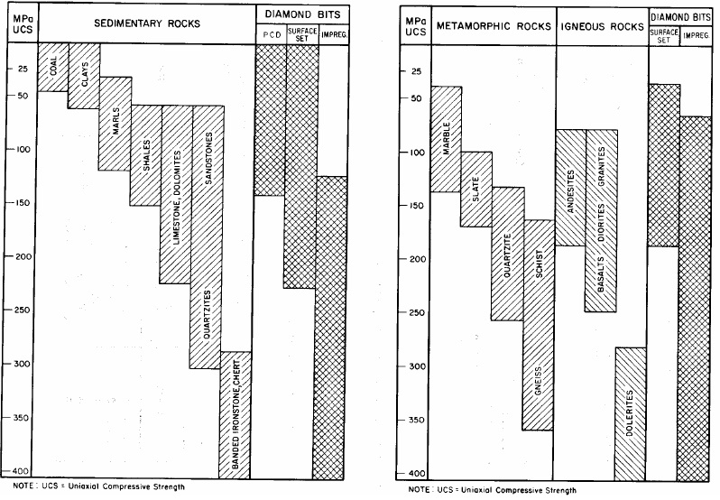
Diamond Bits Recommended for Various Rock Types

Slide 24
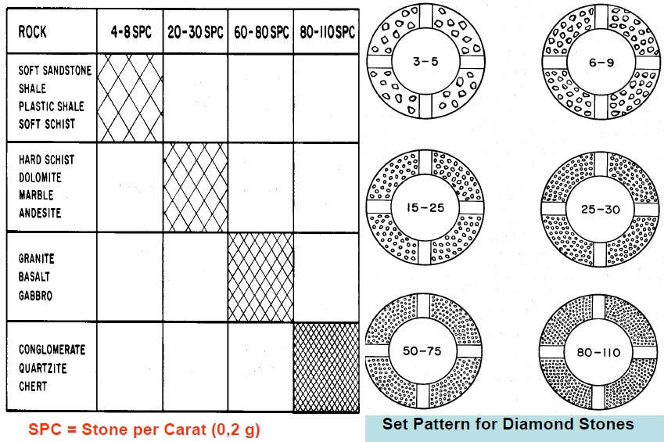
Recommended Diamond Stone Sizes for Various Rock Types

Slide 25
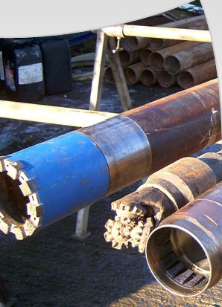
Types of Core Barrels
Core Barrel
Single Tube
Double Tube
Rotating
Stationary
Oilfield
Main Components:
outer core barrel
inner core barrel
core lifter /catcher
thrust bearing
ball valve
Diamond Drilling
WL - Retrievable
Rubber Sleeve
Oriented

Slide 26
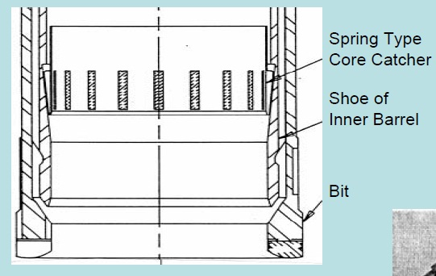
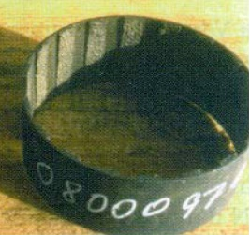
Schematic of Core Catcher
core is lifted after inner core barrel is filled by lifting the outer barrel which subsequently is transferred to the inner barrel (force for catching the core is supported by the outer barrel) wedging the core in the core lifter

Slide 27
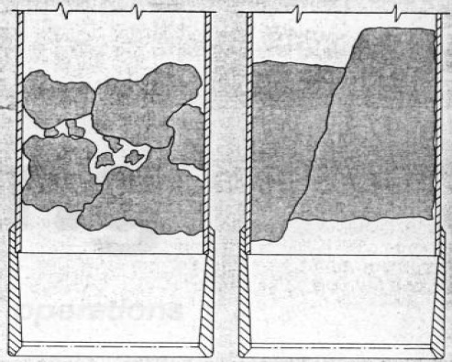
Mechanism of Core Jamming
Consequences of Core Jamming:
premature tripout of core barrel (additional roundtrip time)
damage of core if not recognized
CORE JAMMING INDICATOR

Slide 28
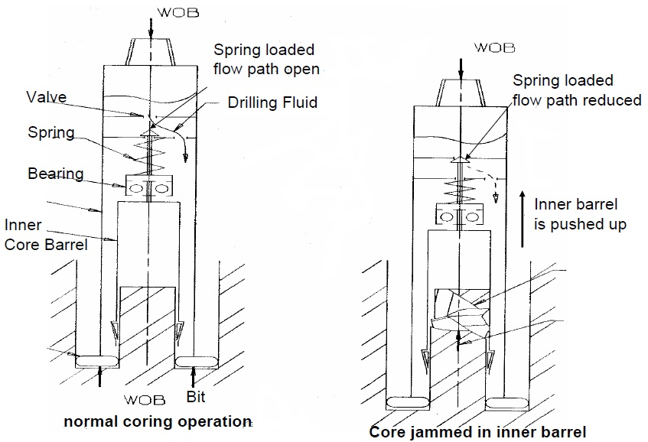
Mechanism of Core Jamming Indicator

Slide 29
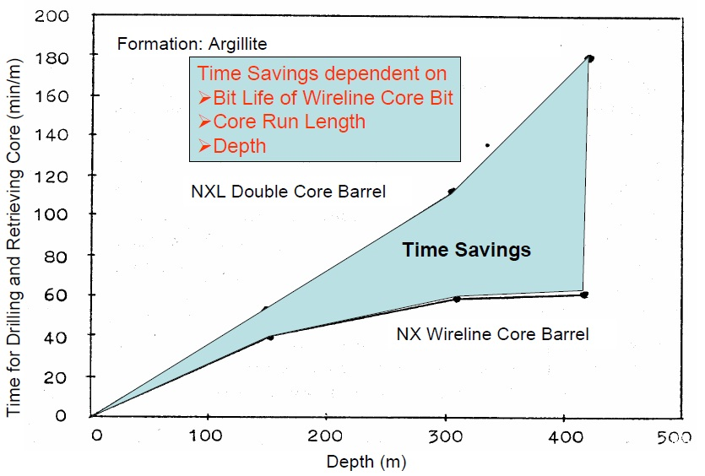
Reasons for Wireline Coring

Slide 30
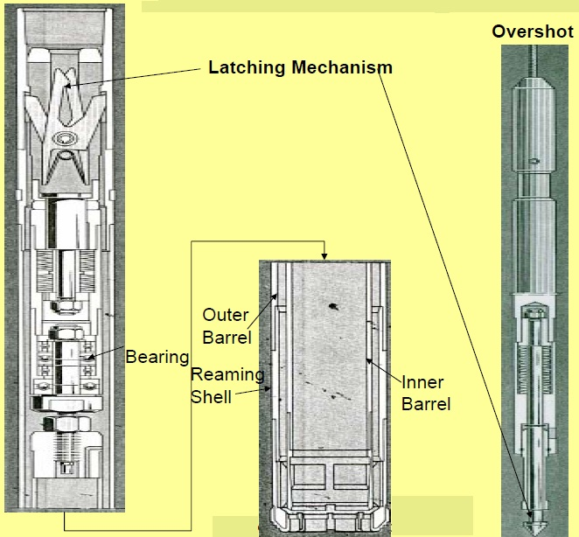
Schematic of Wireline Core Barrels

Slide 31

THE END!!!

Slide 32
Screwing / Unscrewing Drillpipe

