Slide 1

Fundamentals of Onshore Drilling
Fundamentals of Drilling
Directional Drilling –
Fields of Aplication
presentation No. 3
references:
Bernt S. Aadnoy, Iain Cooper, Stefan Z. Miska, Robert F. Mitchell, Michael L. Payne: Advanced Drilling and Well Technology. SPE 2009, ISBN: 978-1-55563-145-1.
Robello G. Samuel, Xiushan Liu: Advanced Drilling Engineering – Principles and Design. Gulf Publishing Company, Houston Texas, 2009,
ISBN: 978-1-933762-34-0.
World Oil´s Handbook of Horizontal Drilling and Completion Technology.
Gulf Publishing Company, Houston, Texas 1991, ISBN: 0-87201-361-8.
A Primer of Oilwell Drilling. Petroleum Extension Service, Houston, Texas 2001, ISBN: 0-88698-194-8.
Directional Drilling and Deviation Control Technology. French Oil and Gas Industry Association Technical Committee, 1990.

Slide 2
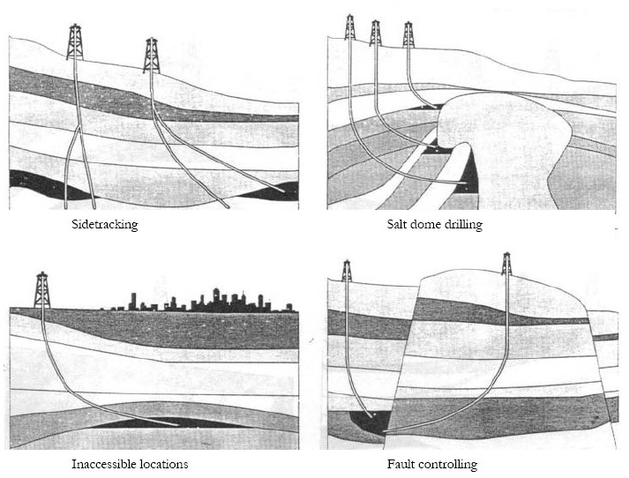
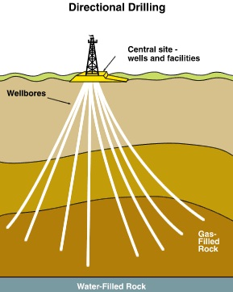
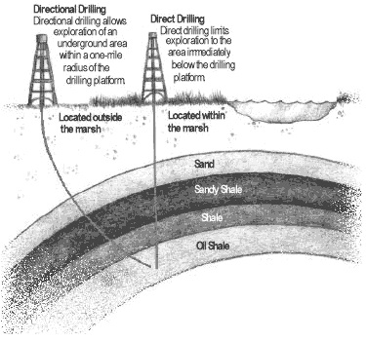
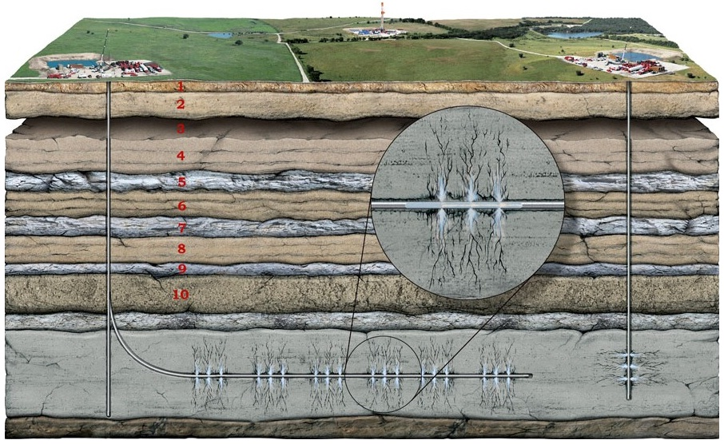
Reasons for Directional Drilling / Deviation Control
1) to reach a planned target area

Slide 3
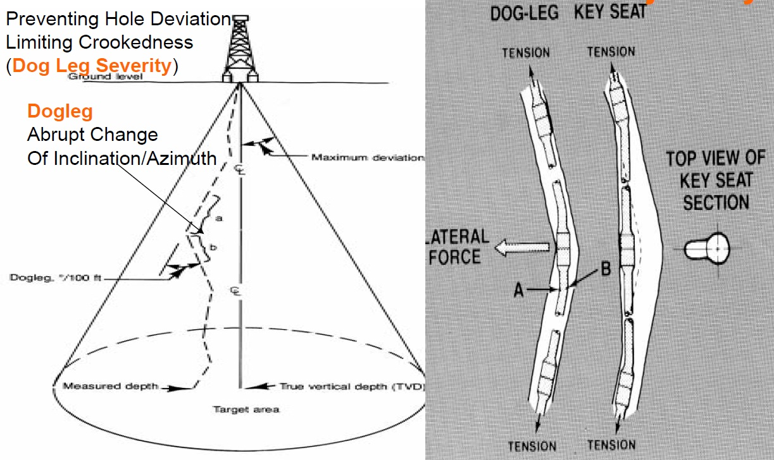
Screwing / Unscrewing Drillpipe
2) to obtain / control a planned hole trajectory

Slide 4
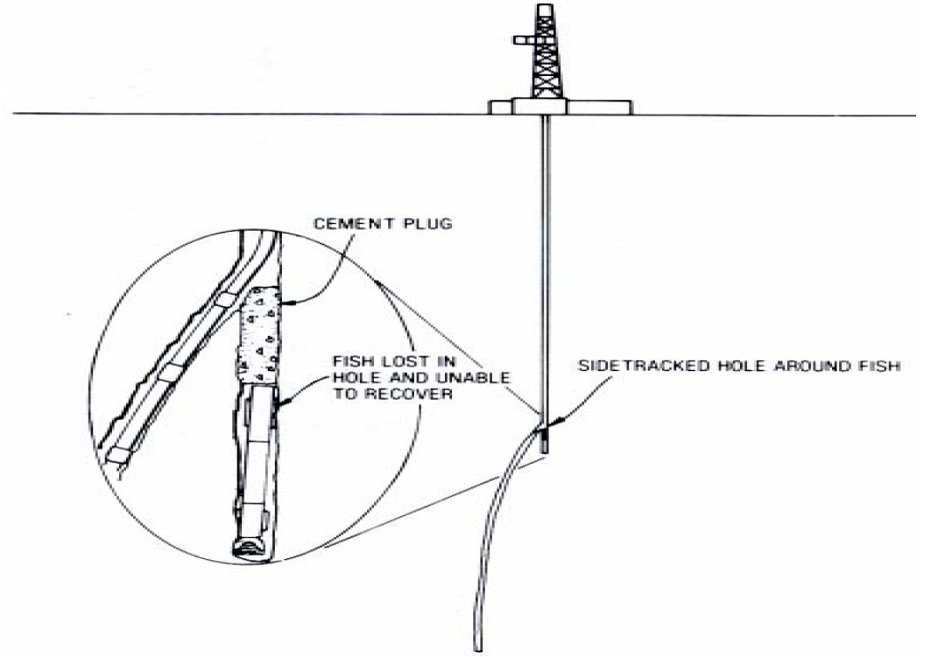
Screwing / Unscrewing Drillpipe
3) to sidetrack or abandon a portion of a hole

Slide 5
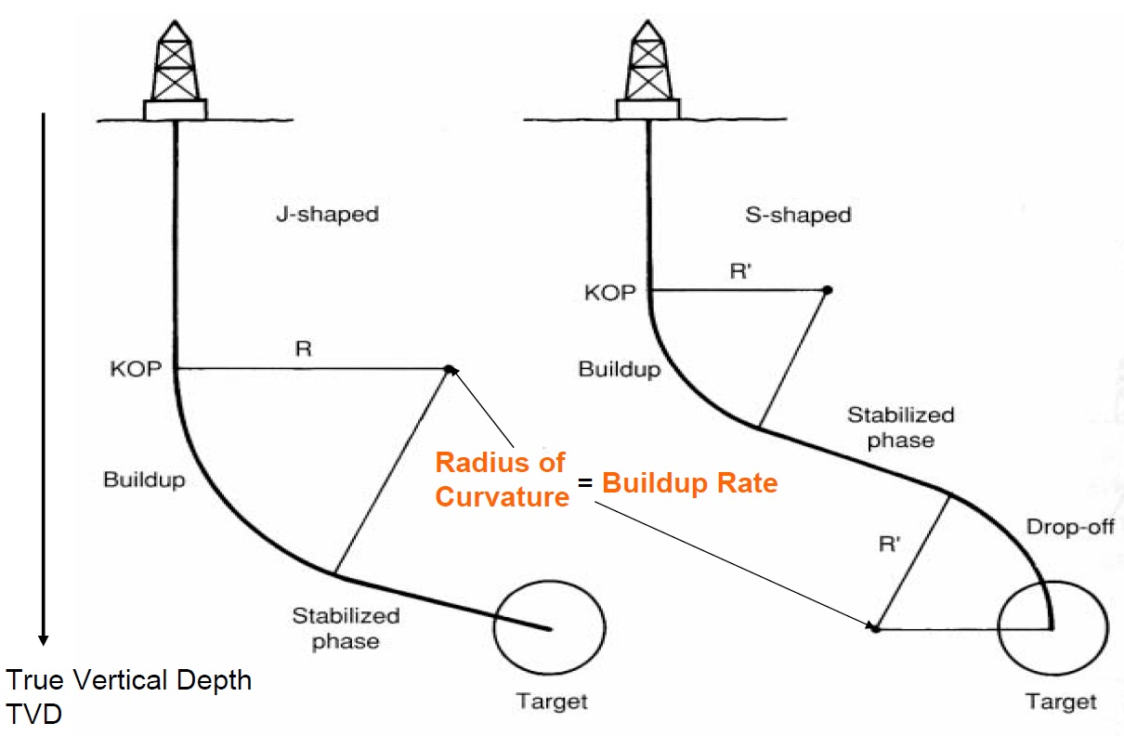
Terminology of Directional Well Profiles

Slide 6
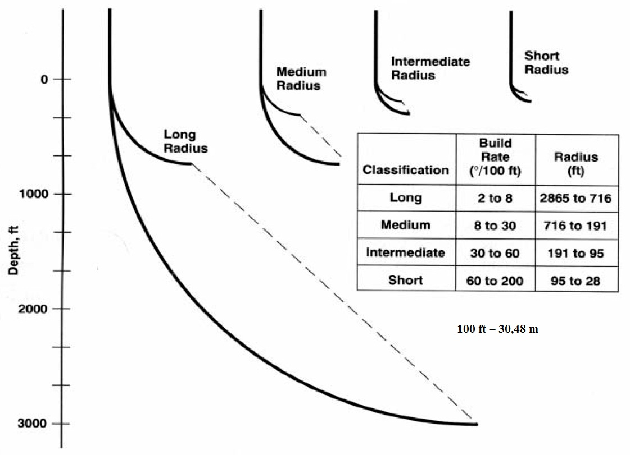
Classification of Buildup - Rates

Slide 7
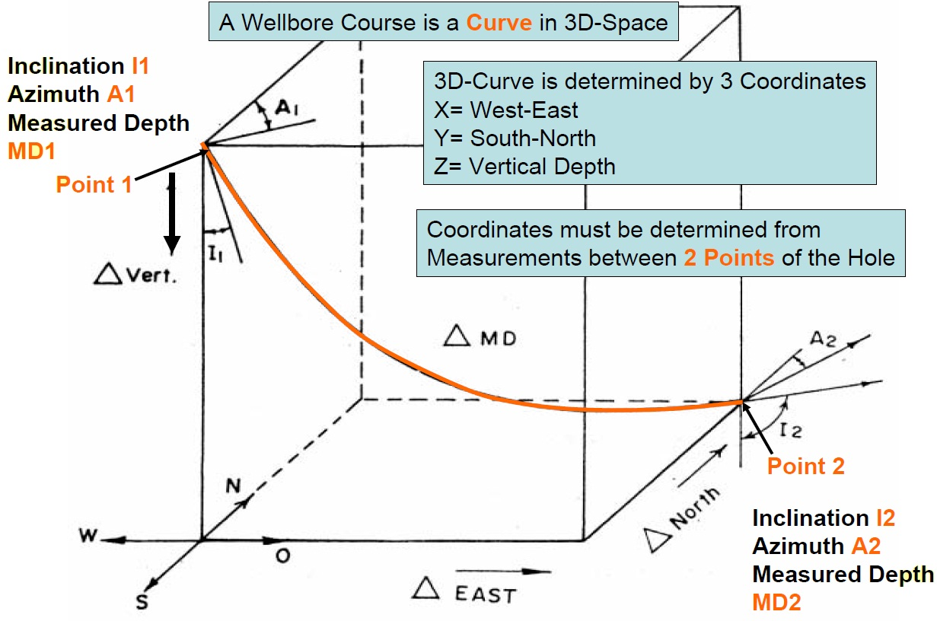
Measuring the Wellbore Course

Slide 8
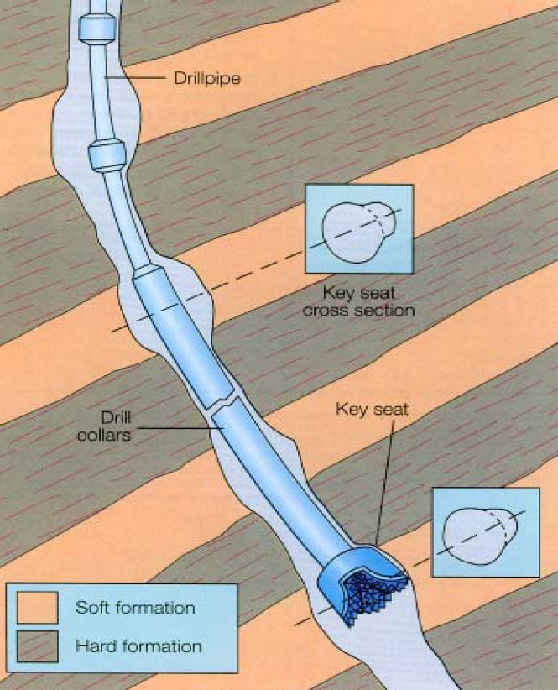
Key Seat Buildup in Doglegs
Dogleg Severity (DLS) means CURVATURE of the hole expressed in Degrees / 100 ft
DLS is critical for:
building of keyseats
torque and drag
casing running operation
running logging sondes

Slide 9
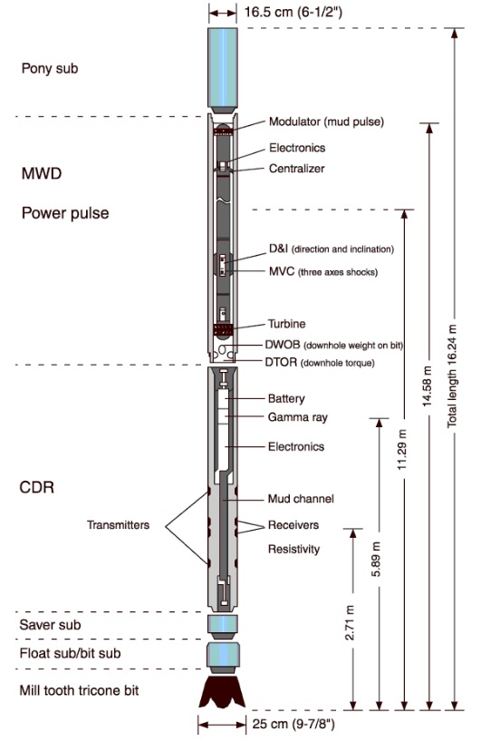
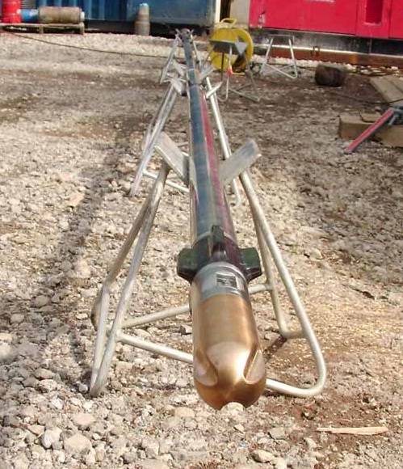
Measurement While Drilling (MWD) Techniques

Slide 10
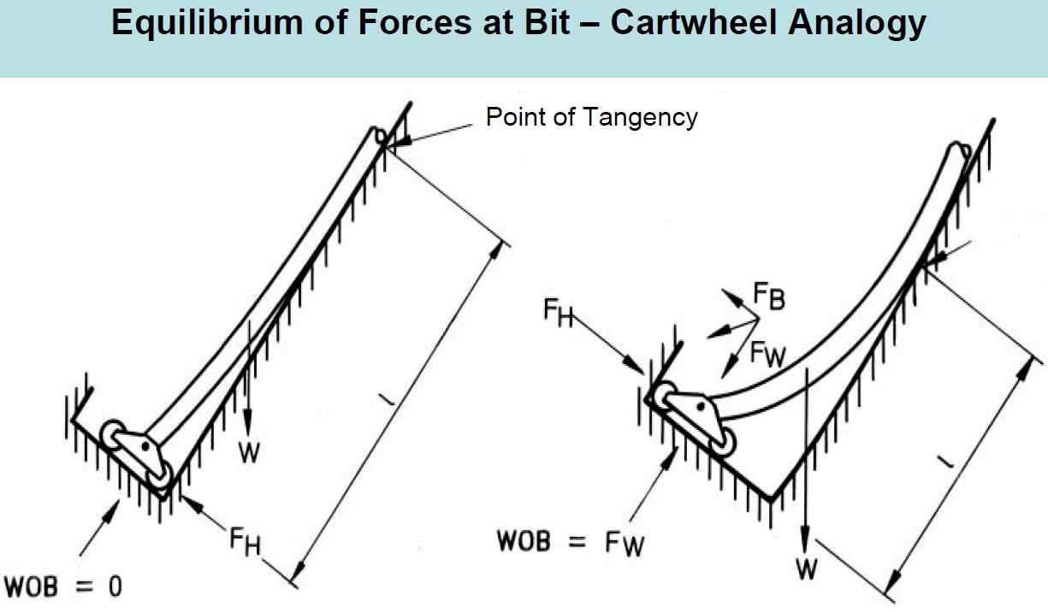
Why Hole Deviation Occurs?

Slide 11
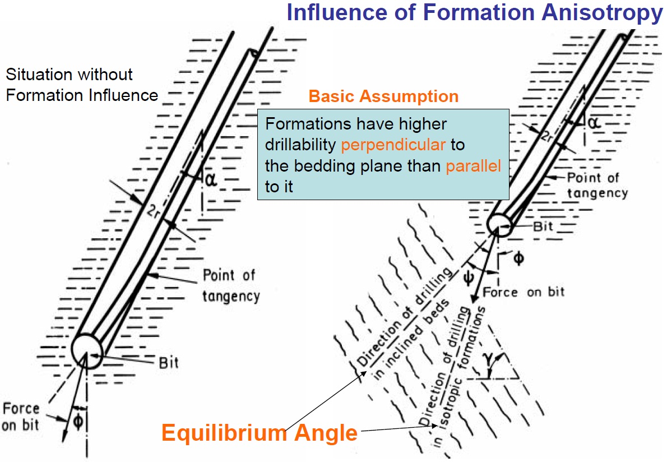
Why Hole Deviation Occurs?

Slide 12
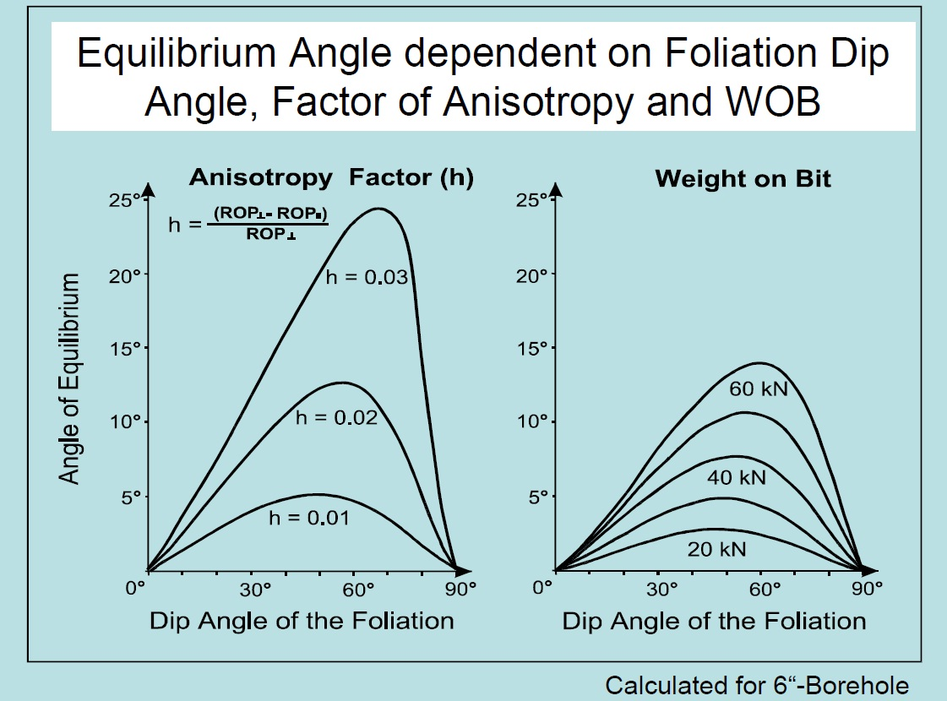

Slide 13
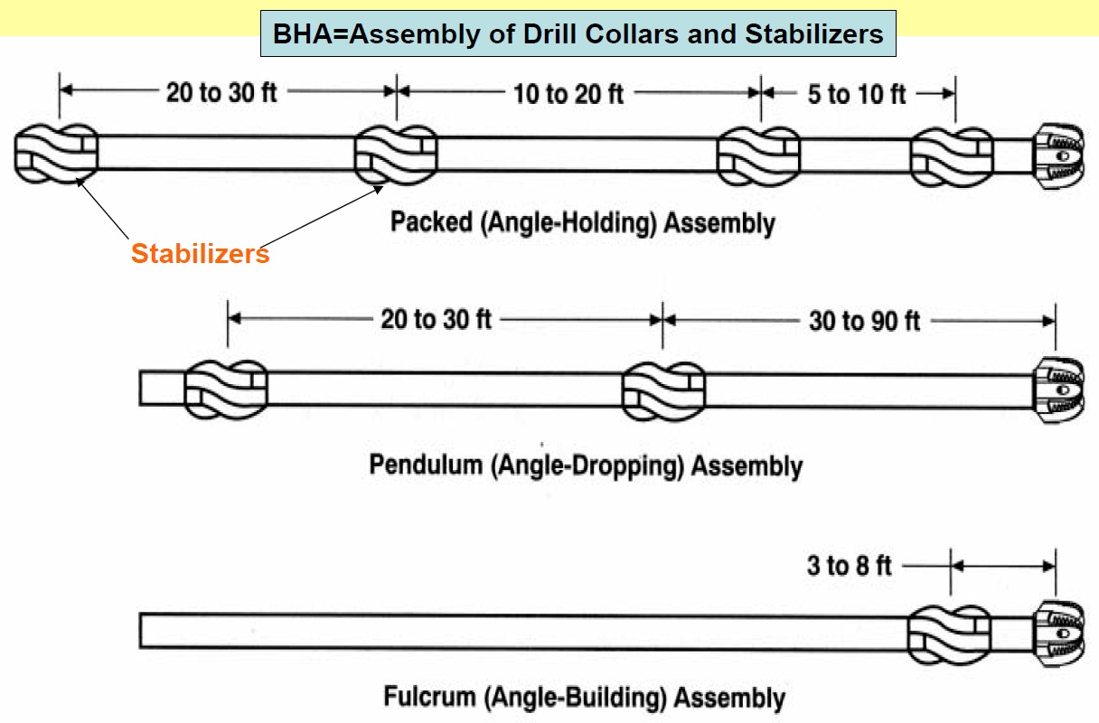
Controlling Hole Inclination by Bottom Hole Assembly (BHA)

Slide 14
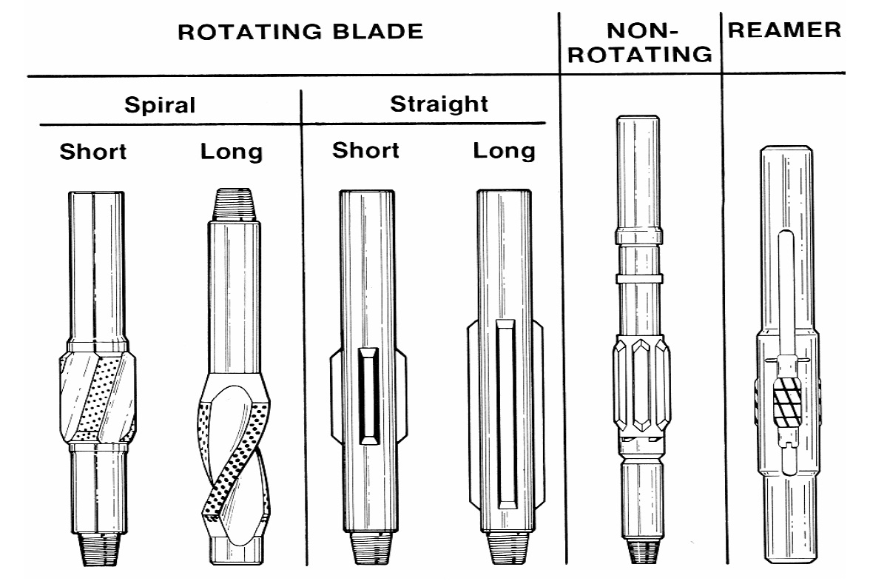
Basic Types of Stabilizing Tools

Slide 15
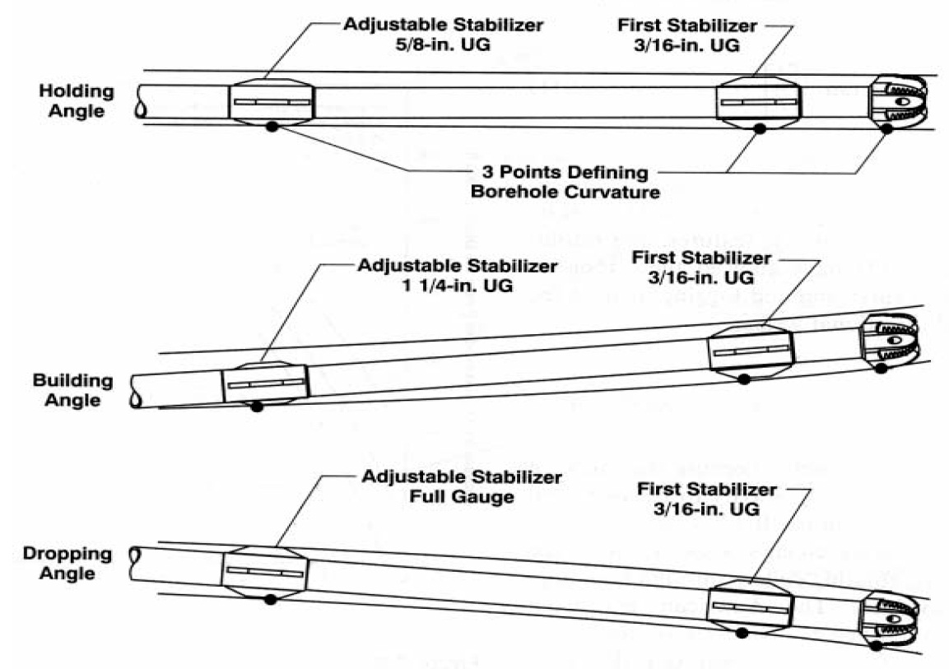
Controling Hole Inclination with Adjustable Stabilizers

Slide 16
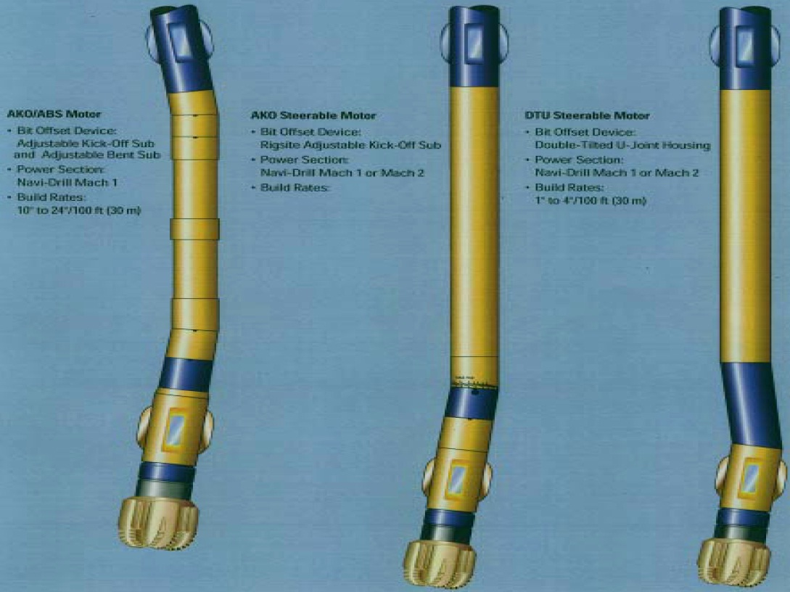
Controlling Wellbore Trajectory with Steerable DHM

Slide 17
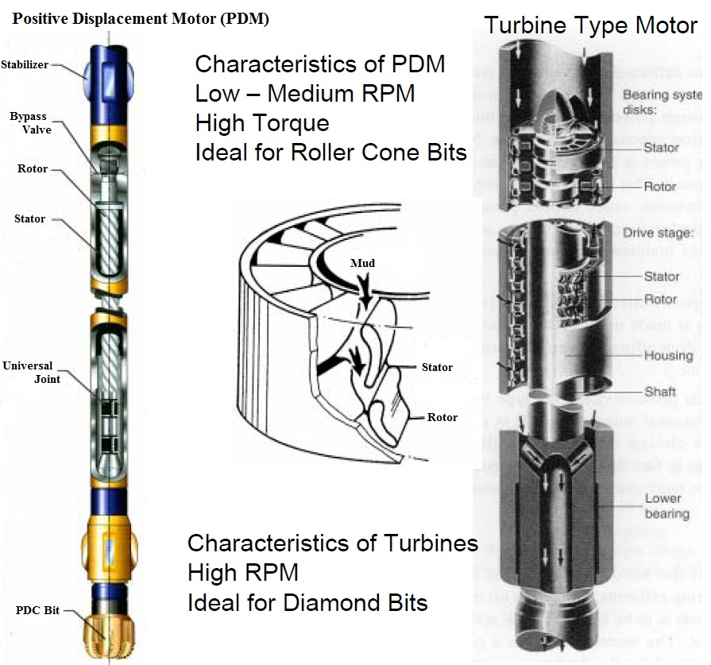
Positive Displacement Motor (PDM)

Slide 18
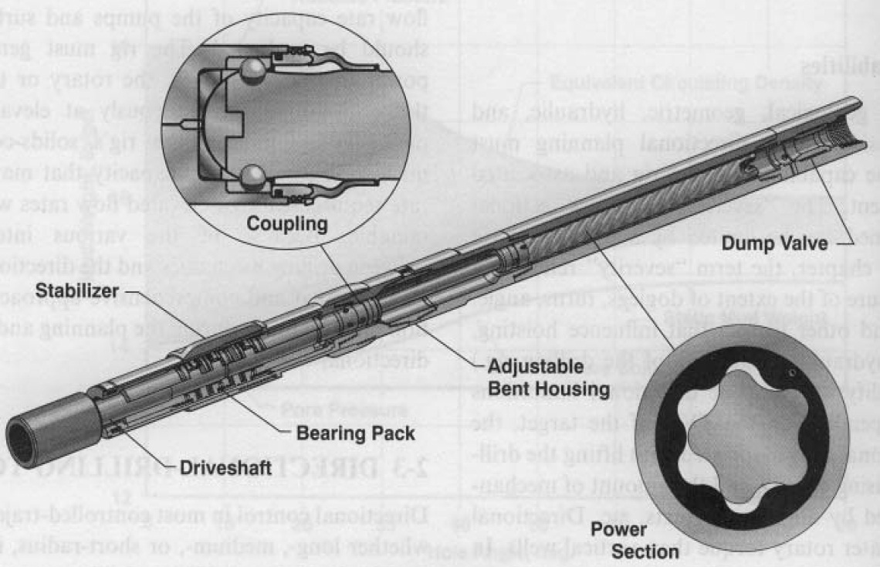
Positive Displacement Motor Components

Slide 19
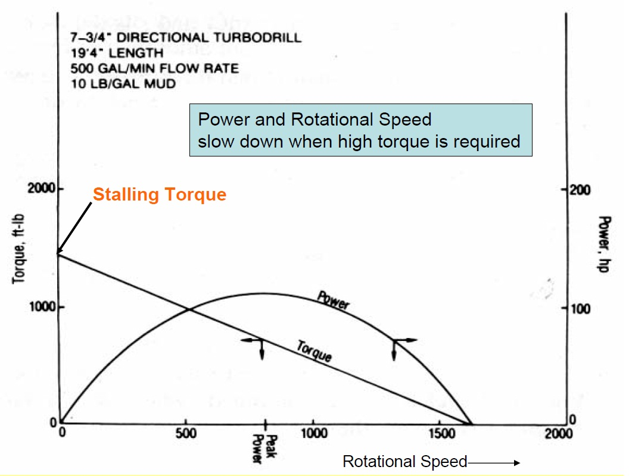
Performance Characteristic of Drilling Turbines

Slide 20
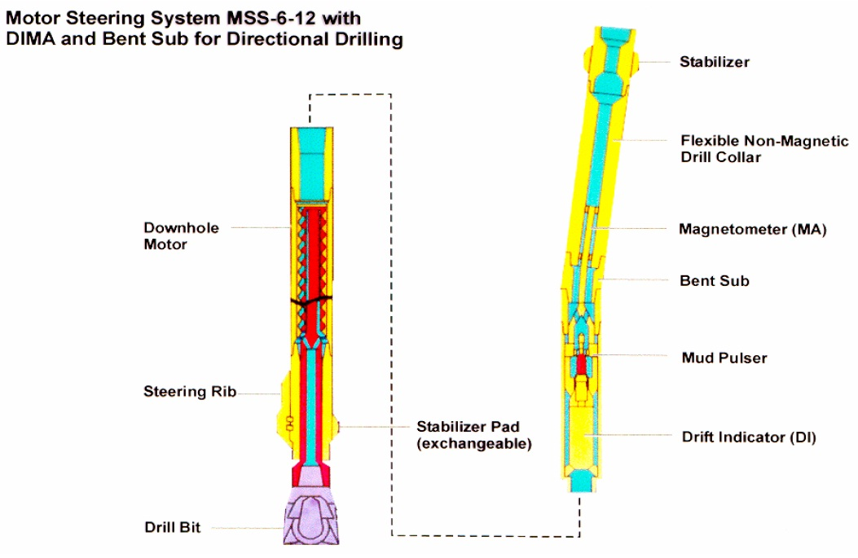
Directional Drilling with DHM – Steering Systems

Slide 21
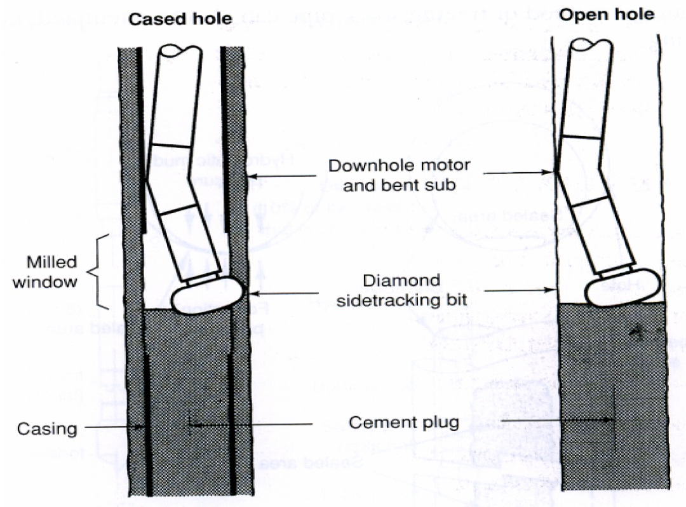
Open Hole and Cased Hole Sidetracking with a Cement Plug

Slide 22
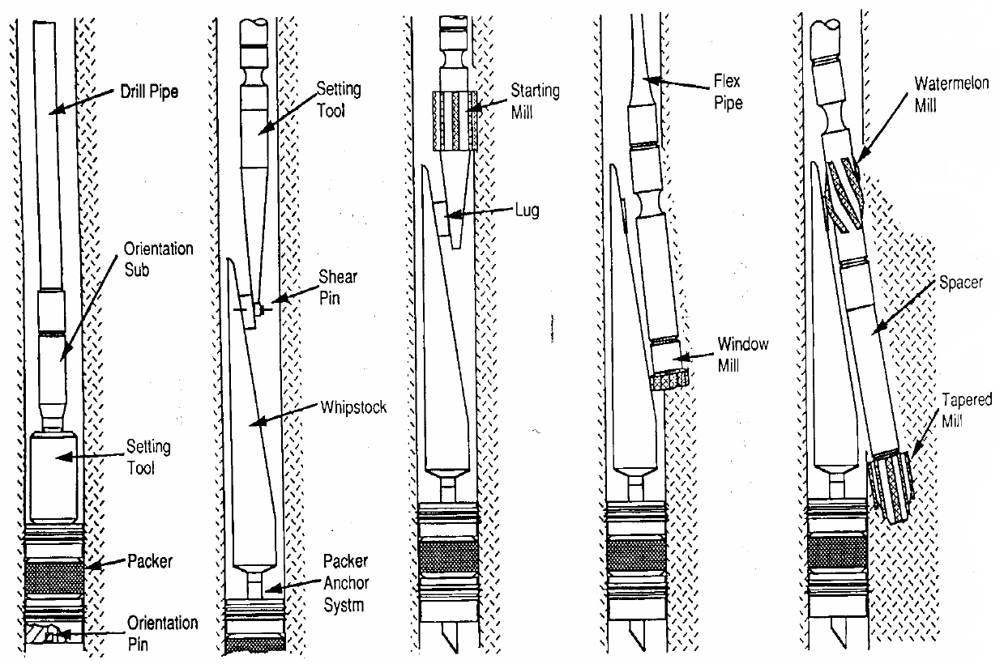
Sidetracking with Oriented Whipstock Technique

Slide 23

THE END!!!

Slide 24
Screwing / Unscrewing Drillpipe

