Slide 1
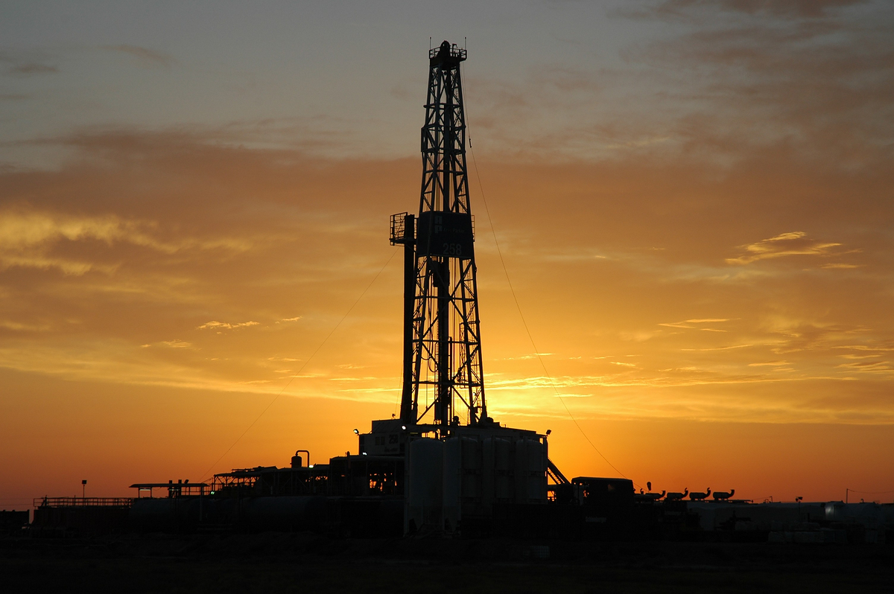
Fundamentals of Onshore Drilling
Fundamentals of Drilling
Principles of Drilling
Fluid Technology
presentation No. 5
references:
Bernt S. Aadnoy, Iain Cooper, Stefan Z. Miska, Robert F. Mitchell, Michael L. Payne: Advanced Drilling and Well Technology. SPE 2009, ISBN: 978-1-55563-145-1.
Robello G. Samuel, Xiushan Liu: Advanced Drilling Engineering – Principles and Design. Gulf Publishing Company, Houston Texas, 2009,
ISBN: 978-1-933762-34-0.
Boyun Guo, Gefei Liu: Applied Drilling Circulation Systems (Hydraulics, Calculations and Models). Gulf Publishing Company, Houston Texas, 2011,
ISBN: 978-0-12-381957-4.
Drilling Fluids Processing Handbook . Gulf Publishing Company, Houston Texas, 2004, ISBN: 978-0-7506-7775-2.
Robello, R. G.: Downhole Drilling Tools. Gulf Publishing Company, Houston, Texas
2007, ISBN: 978-1933762135.

Slide 2
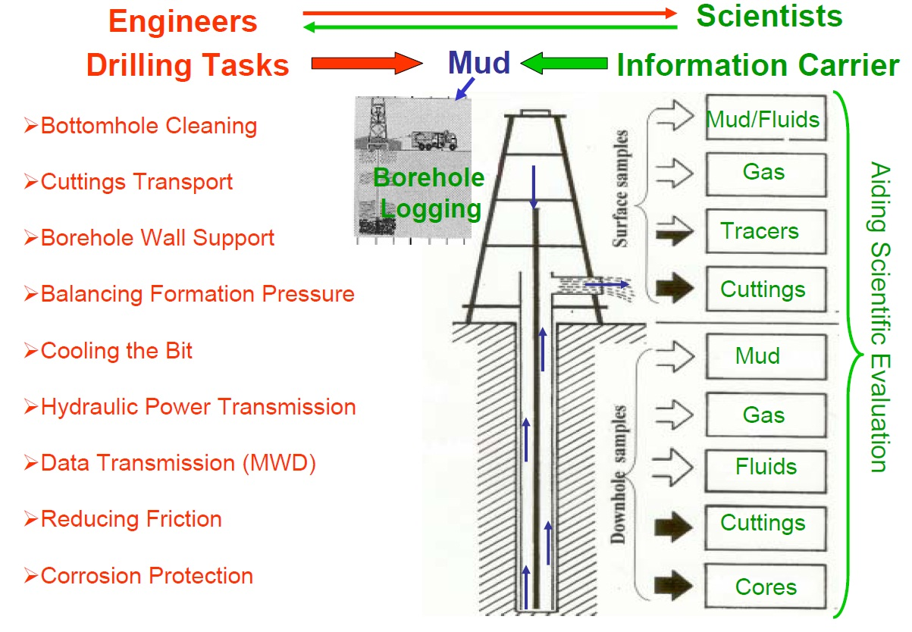
Drilling Mud – Why do We Deal With?

Slide 3
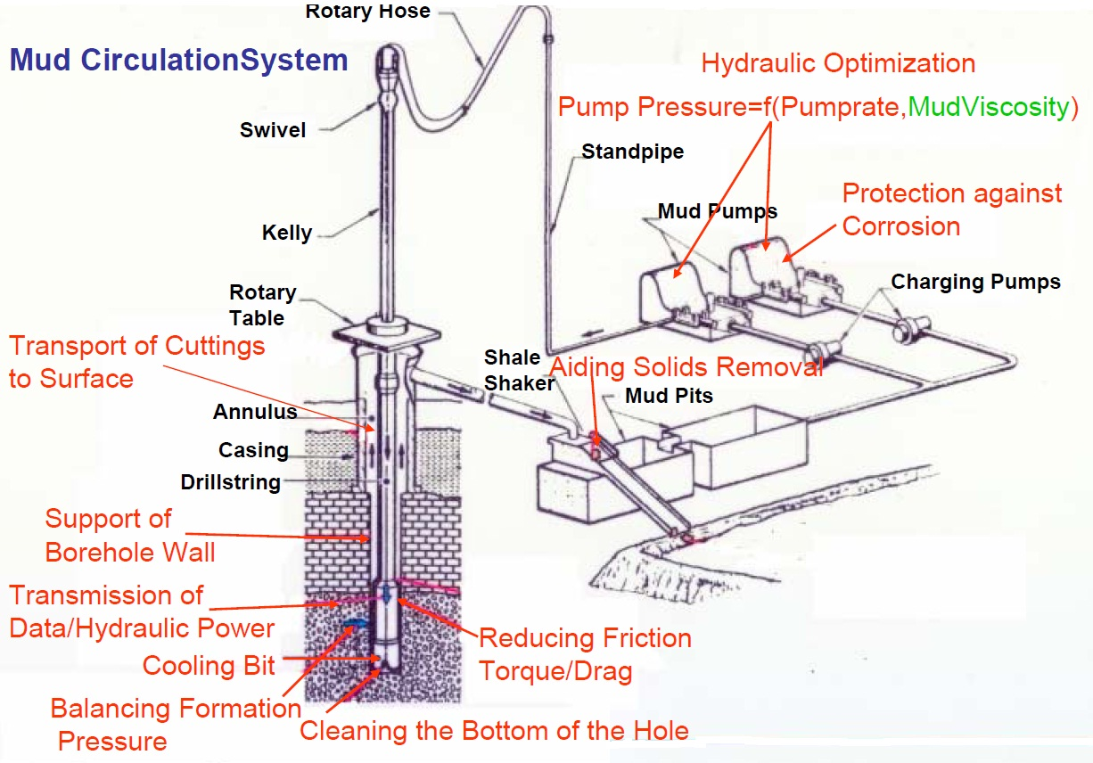
Technical Key Functions of Drilling Fluids

Slide 4
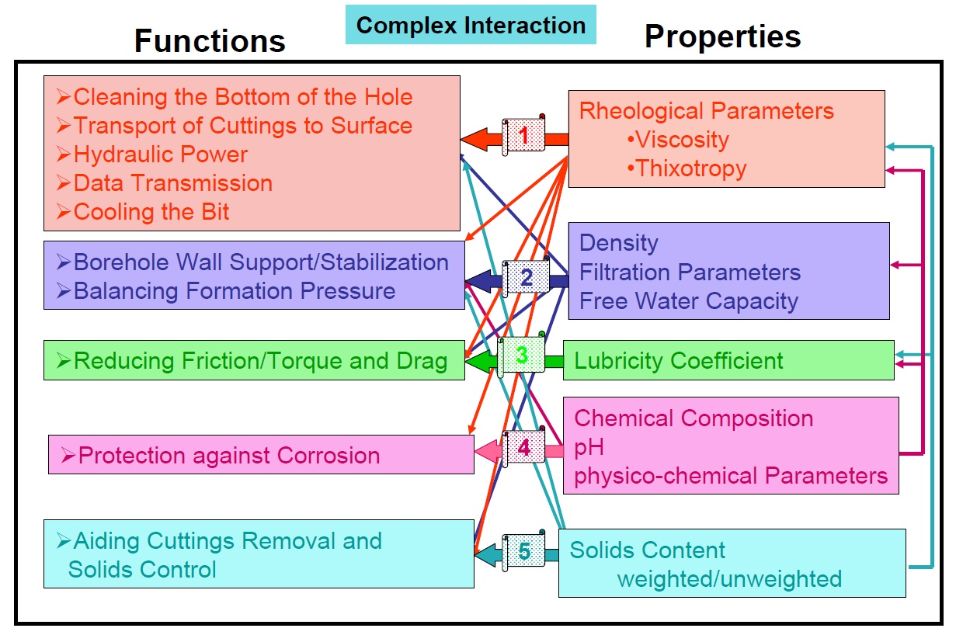
Mud Properties Controlling Technical Key Functions

Slide 5

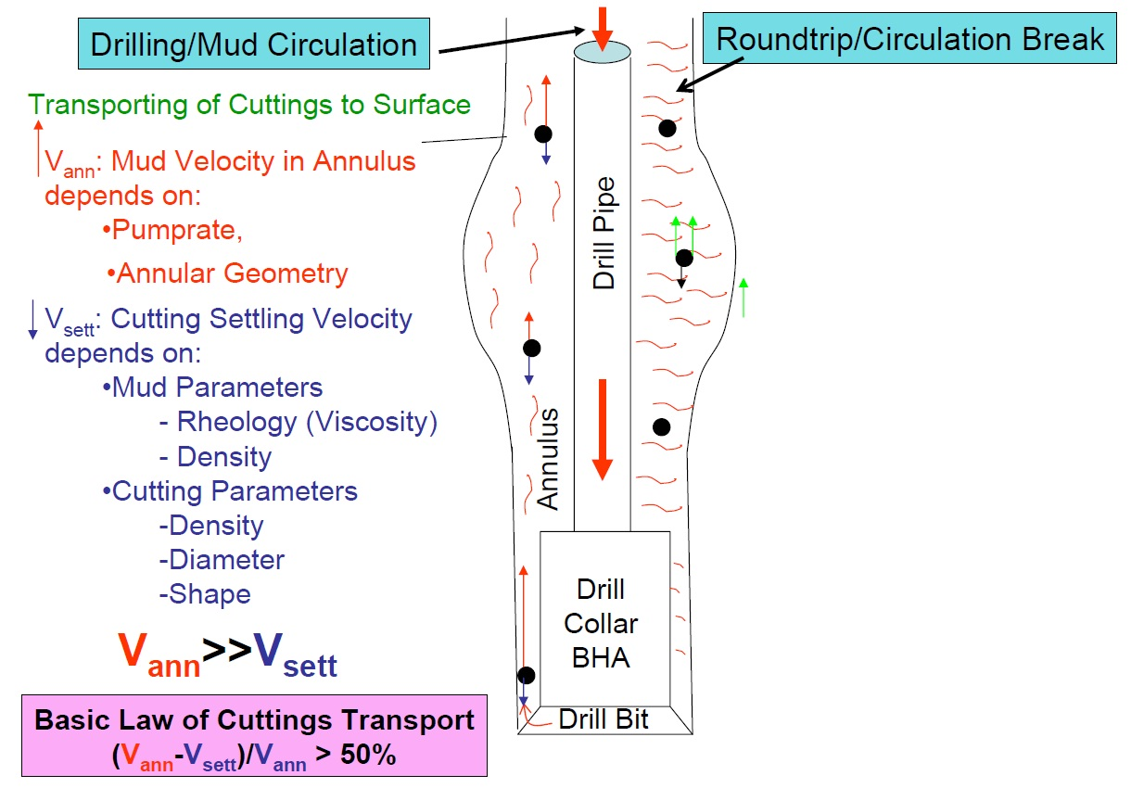
Fundamentals of Cutting Transport

Slide 6
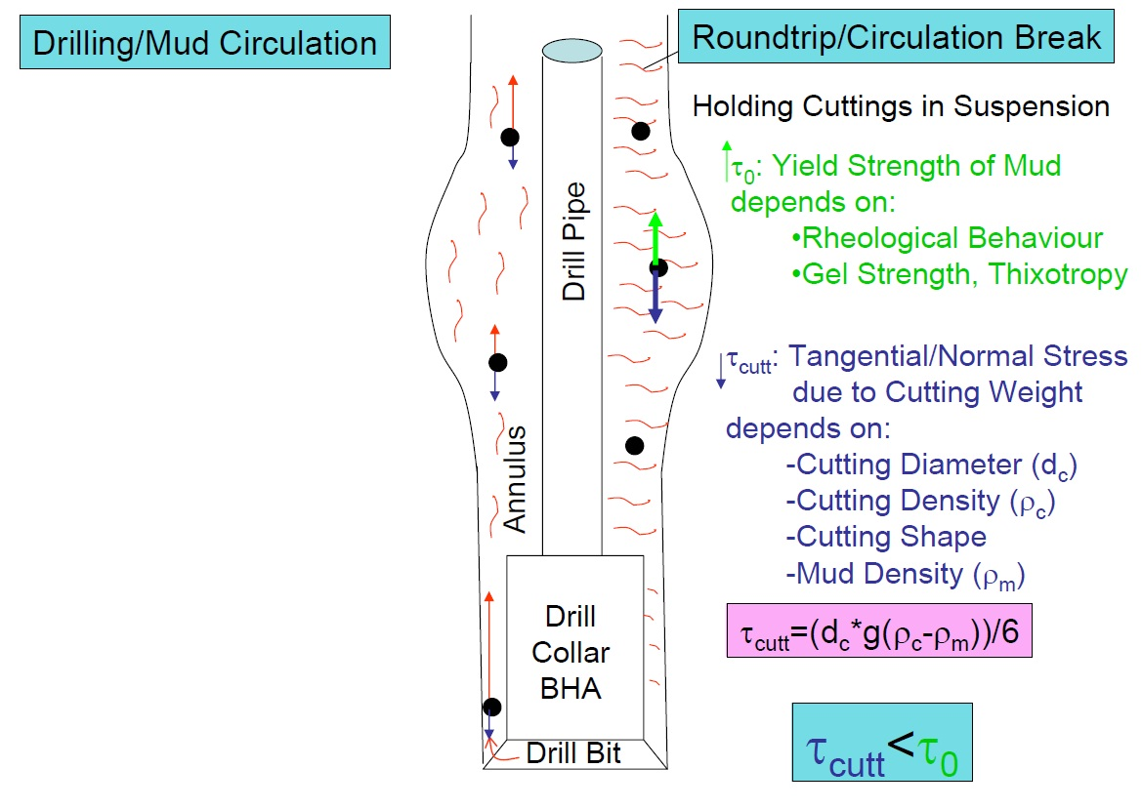
Fundamentals of Cutting Transport

Slide 7
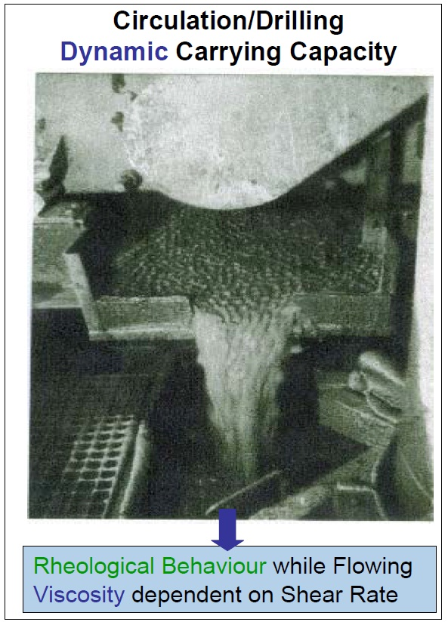
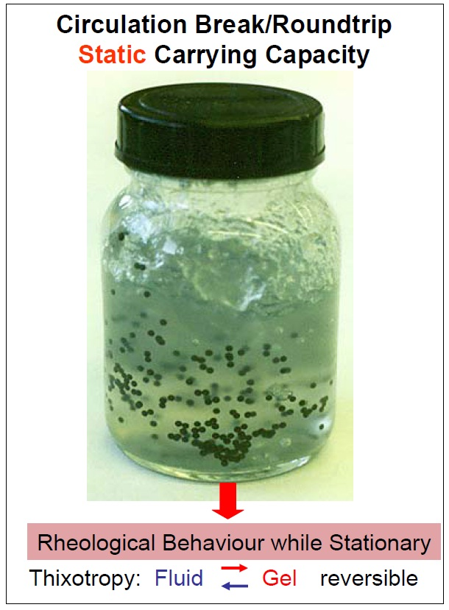
Cutting Transport – The Role of Drilling Fluid Rheology

Slide 8
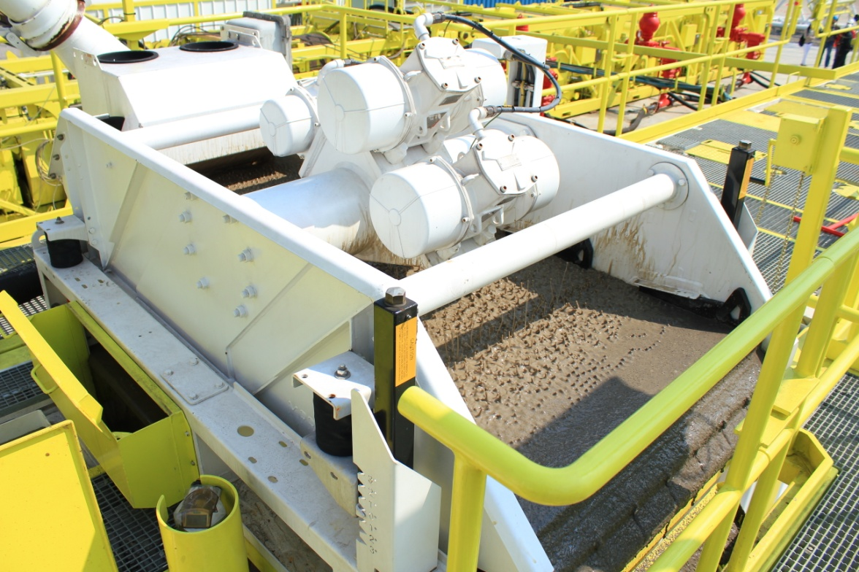
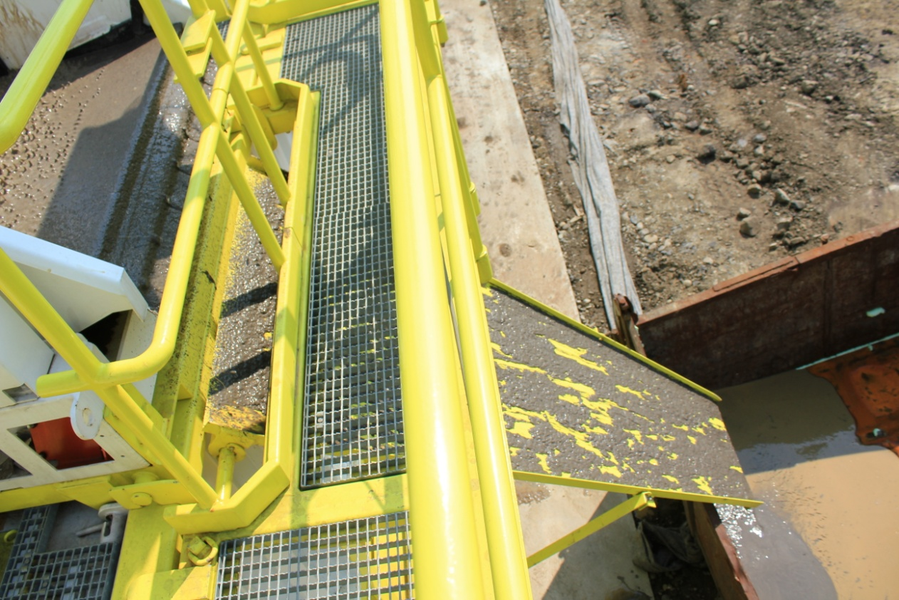
Cutting Transport – The Role of Drilling Fluid Rheology

Slide 9
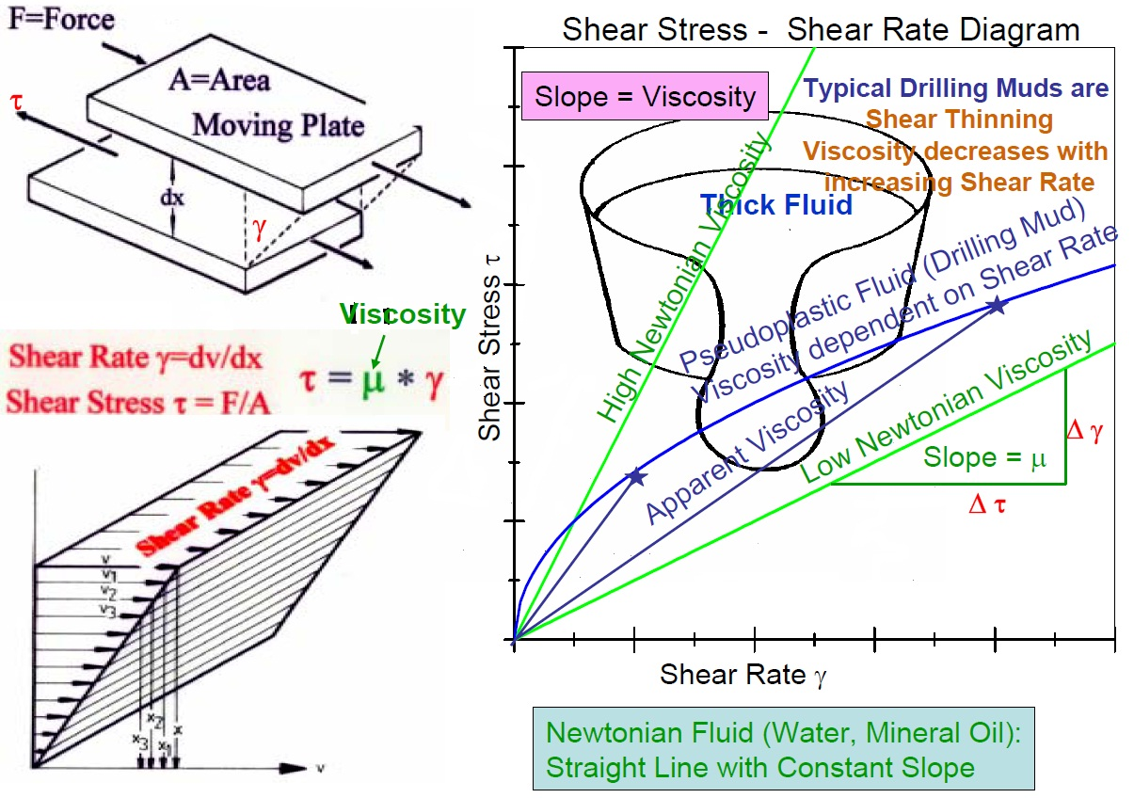
Theory of Fluid Rheology

Slide 10
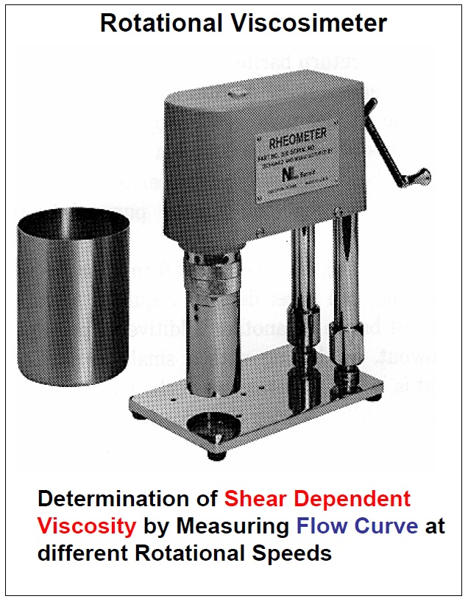
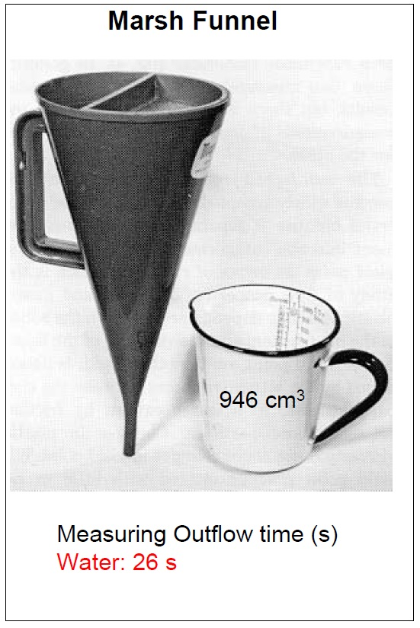
Drilling Mud Viscosity – Measuring Equipment

Slide 11
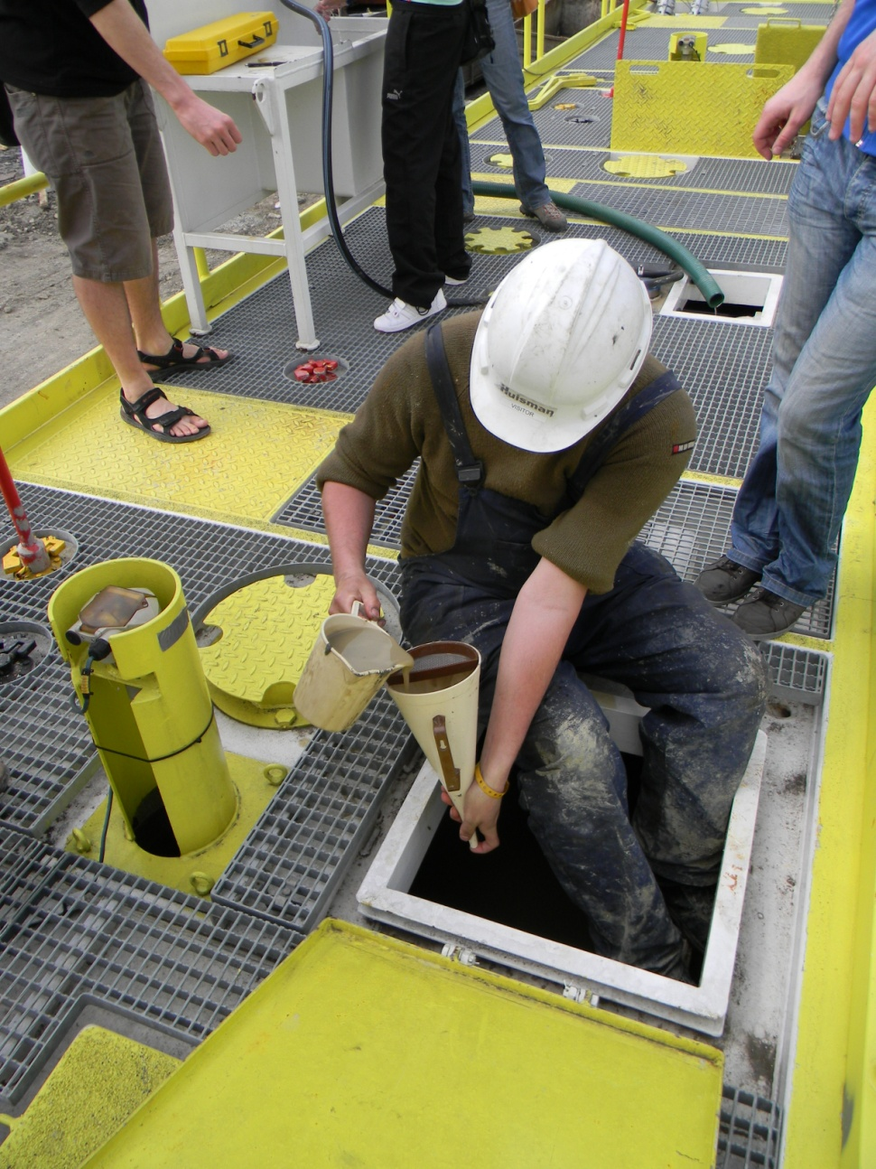
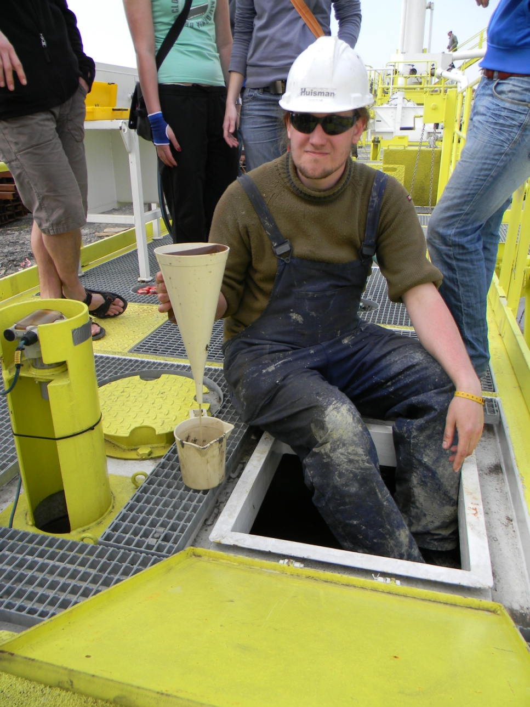
Drilling Mud Viscosity – Measuring Equipment

Slide 12
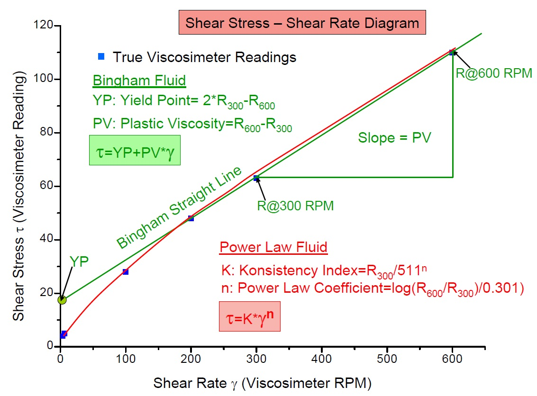
Flow Models Describing Pseudoplastic Drilling Fluid Rheology

Slide 13
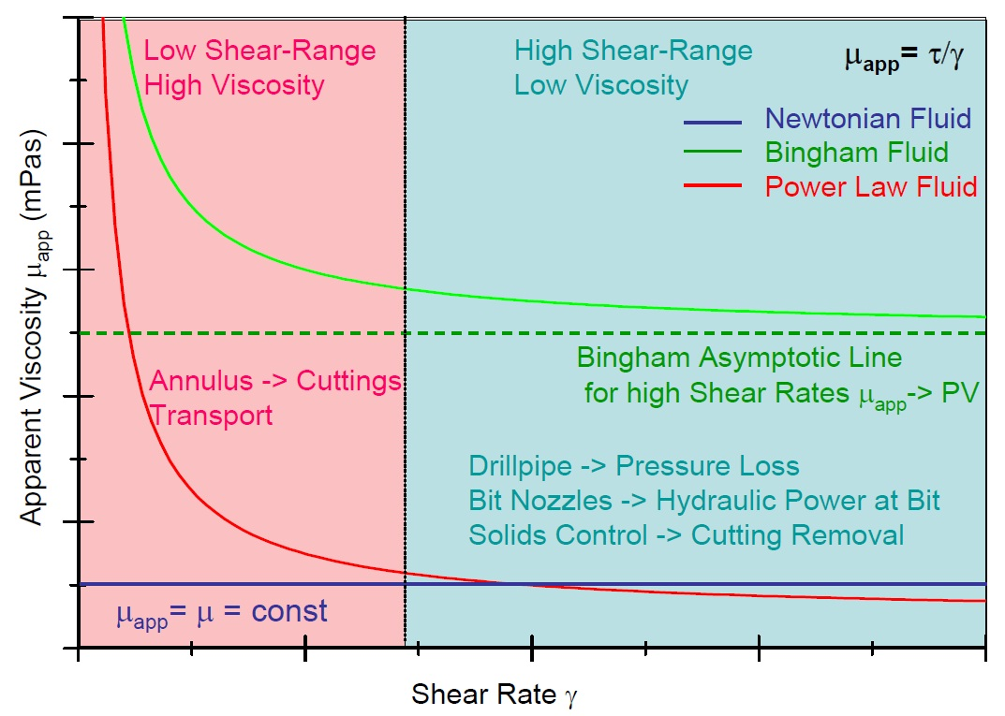
Shear Thinning of Drilling Fluids – Influence on Drilling Process

Slide 14
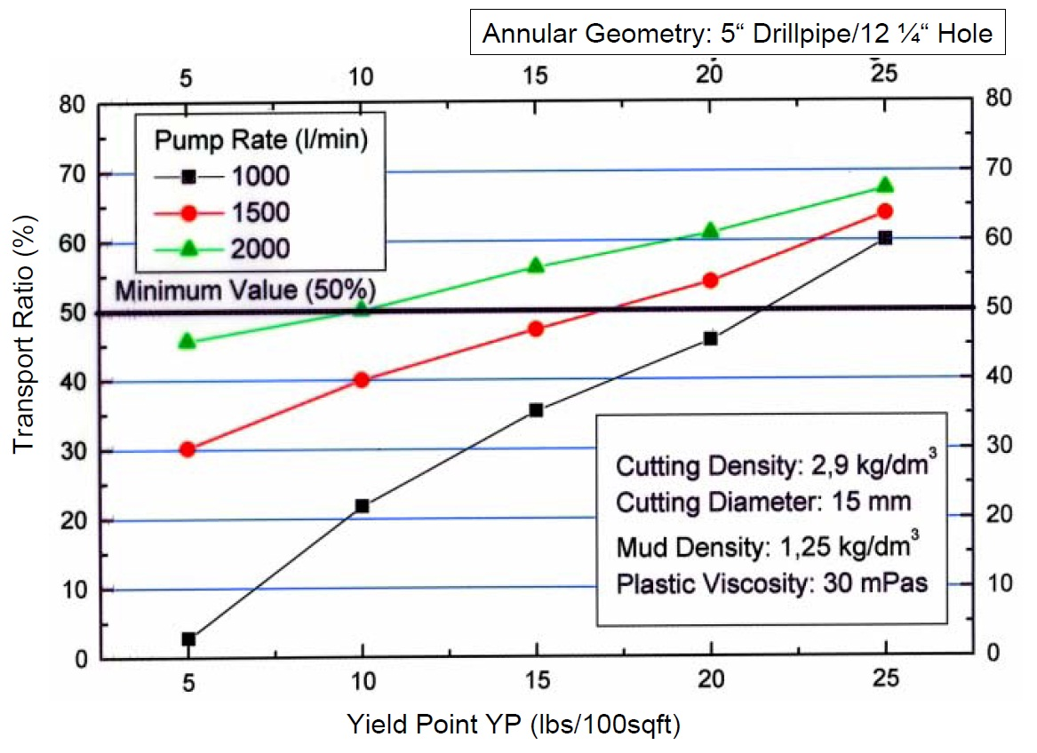
Influence of Yield Point on Cuttings Transport Efficiency

Slide 15
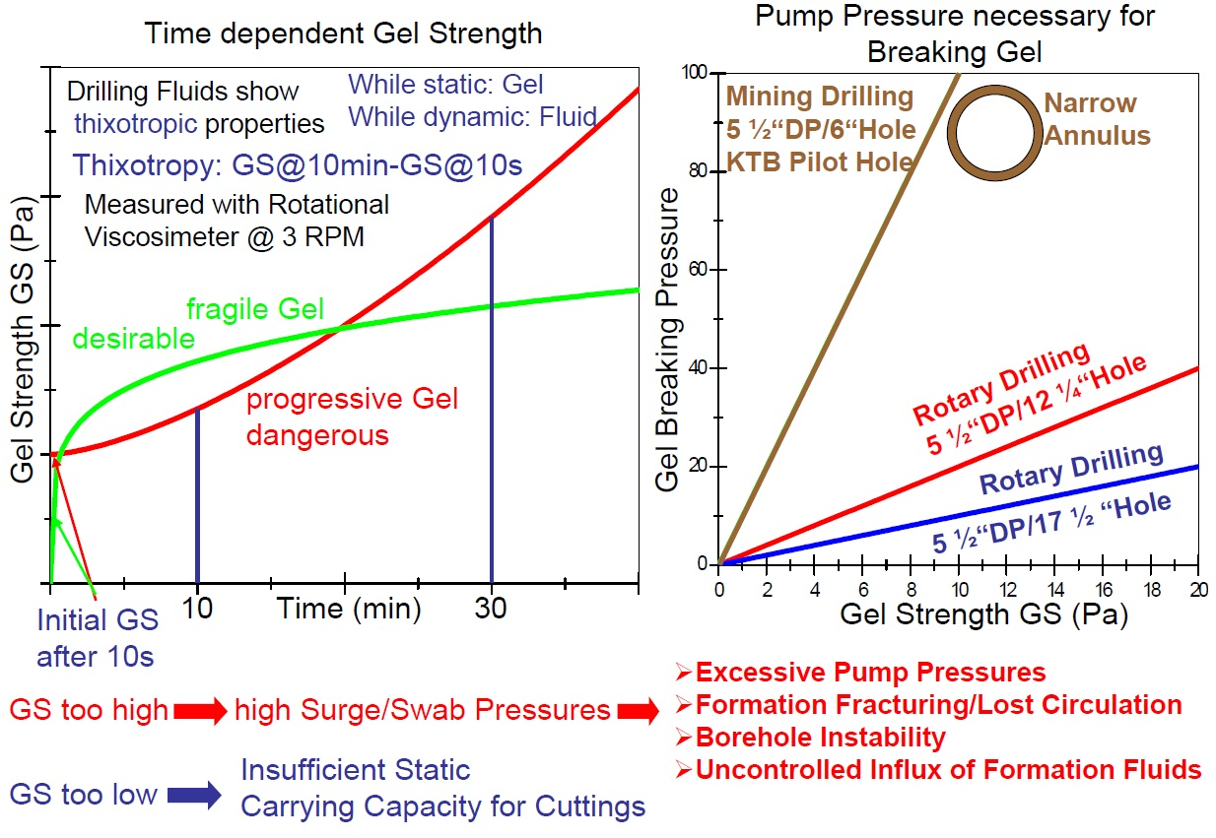
Gel Building Properties of Drilling Fluids

Slide 16
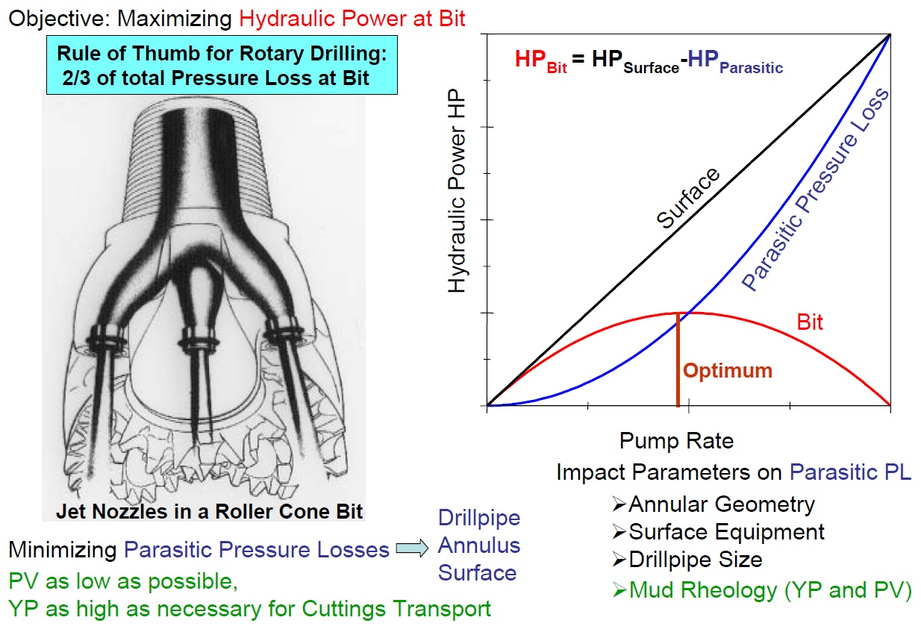
Optimizing Drilling Hydraulics

Slide 17
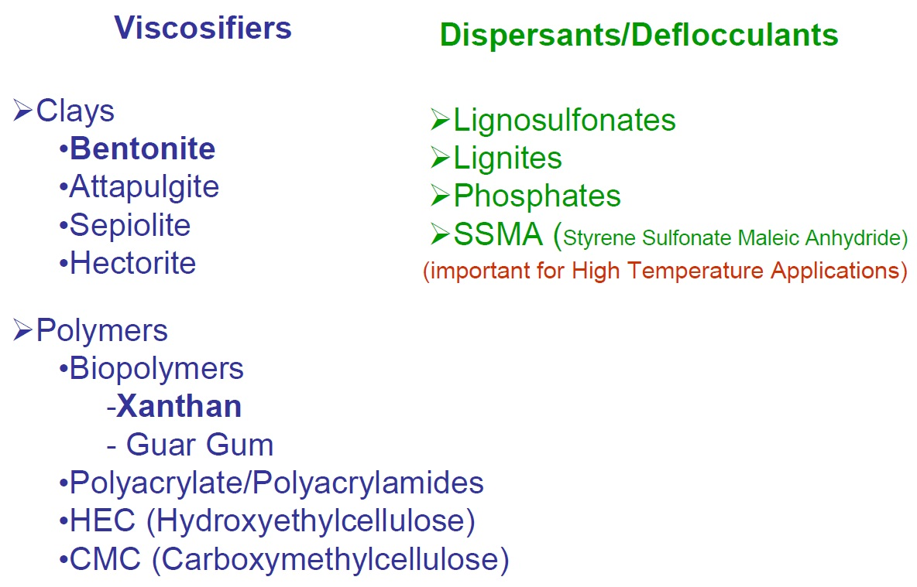
Mud Additives Controlling Rheology

Slide 18
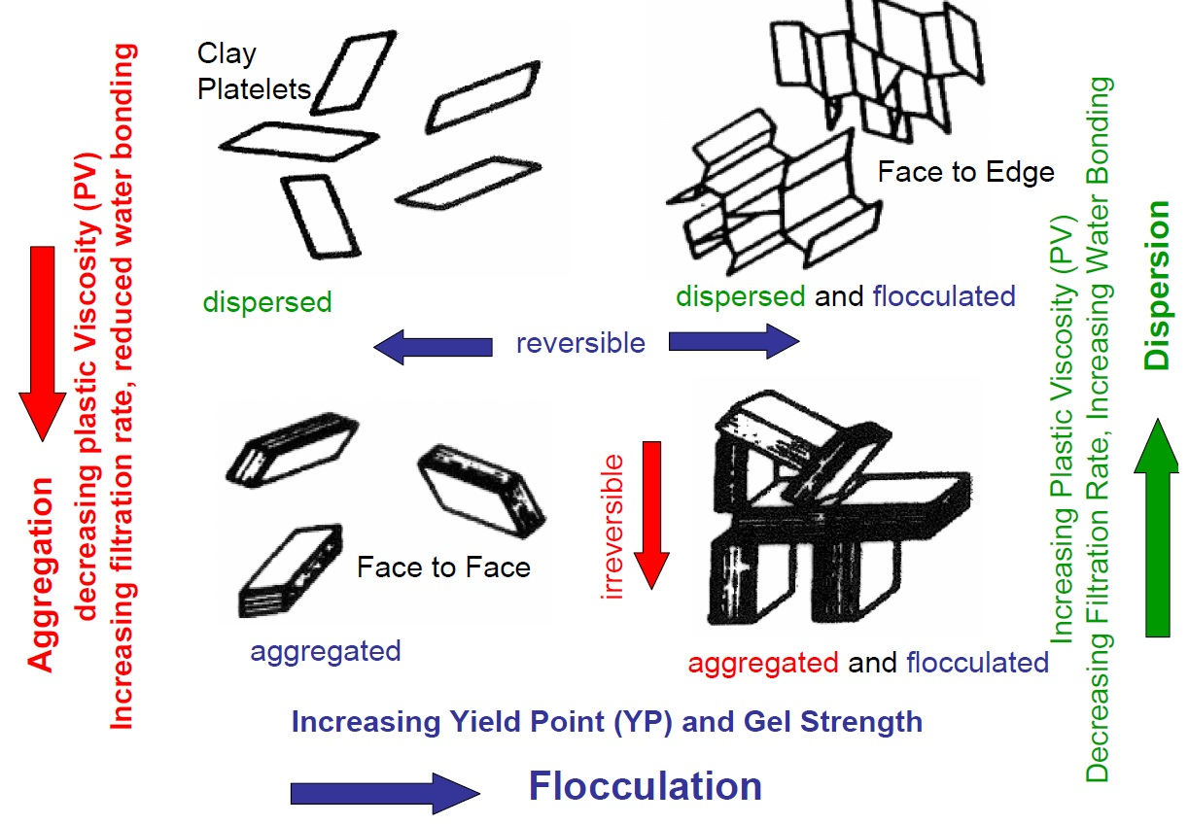
State Diagram of Colloidal Montmorillonite Suspension in Water

Slide 19

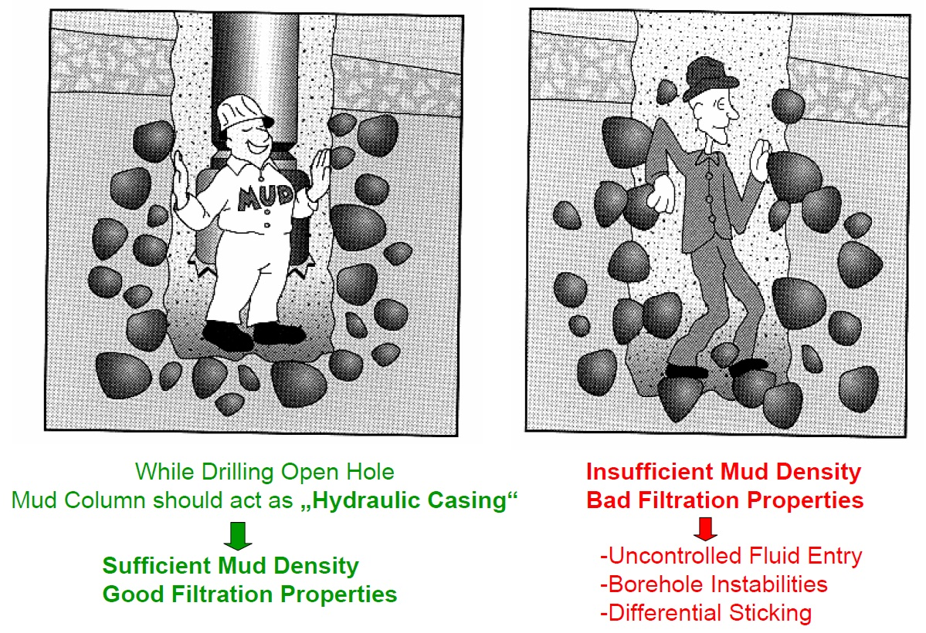
Support of the Borehole Wall – Balancing Formation Pressure

Slide 20
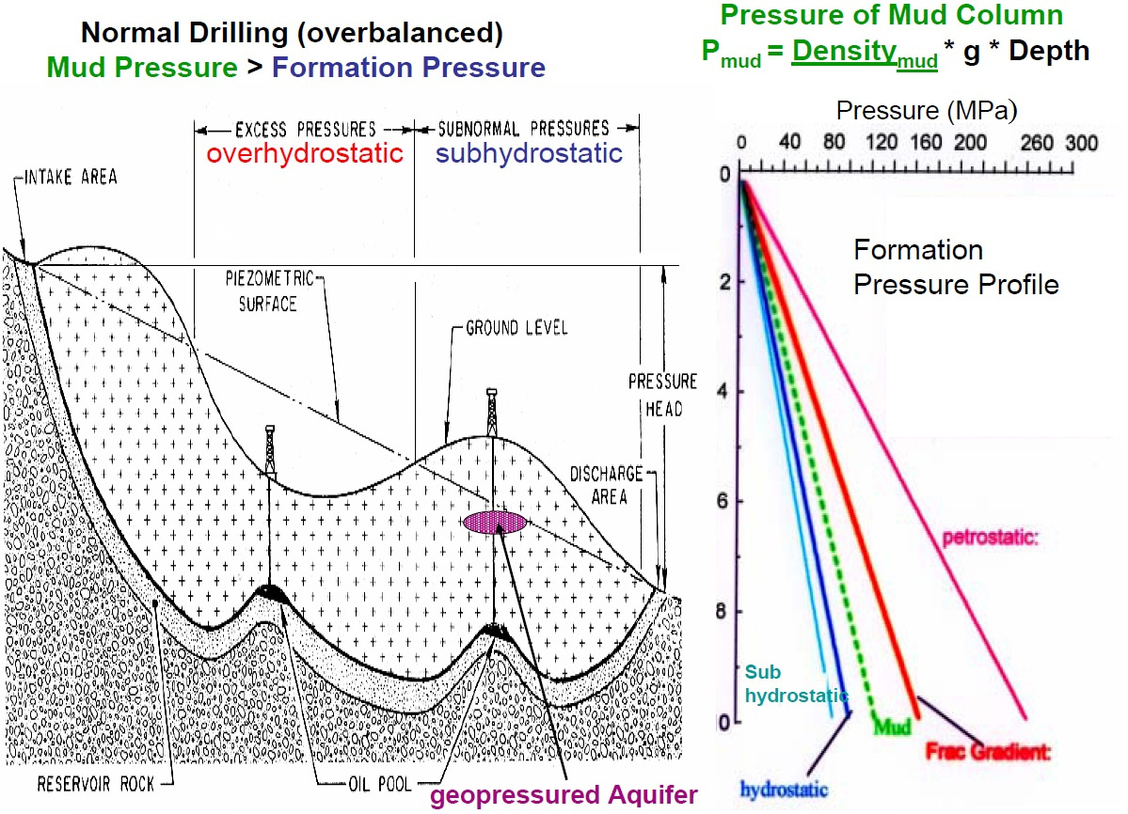
Balancing FormationPressures

Slide 21
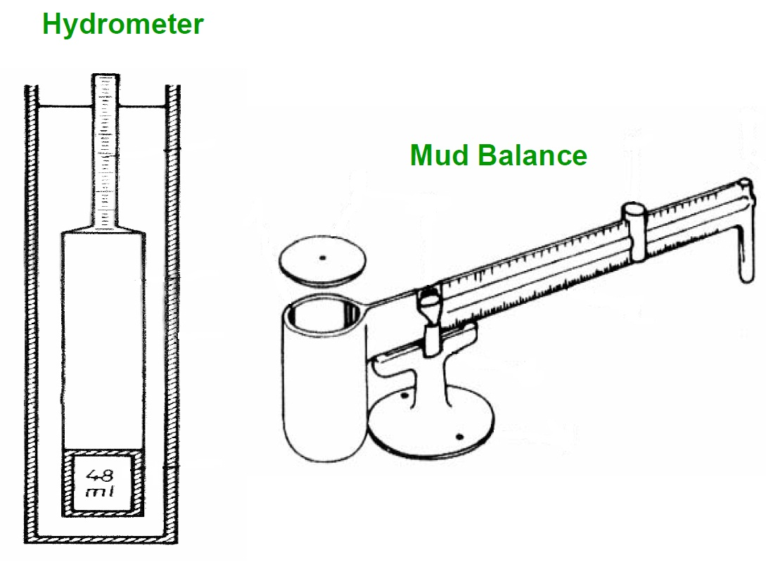
Instruments for Measuring Mud Density

Slide 22
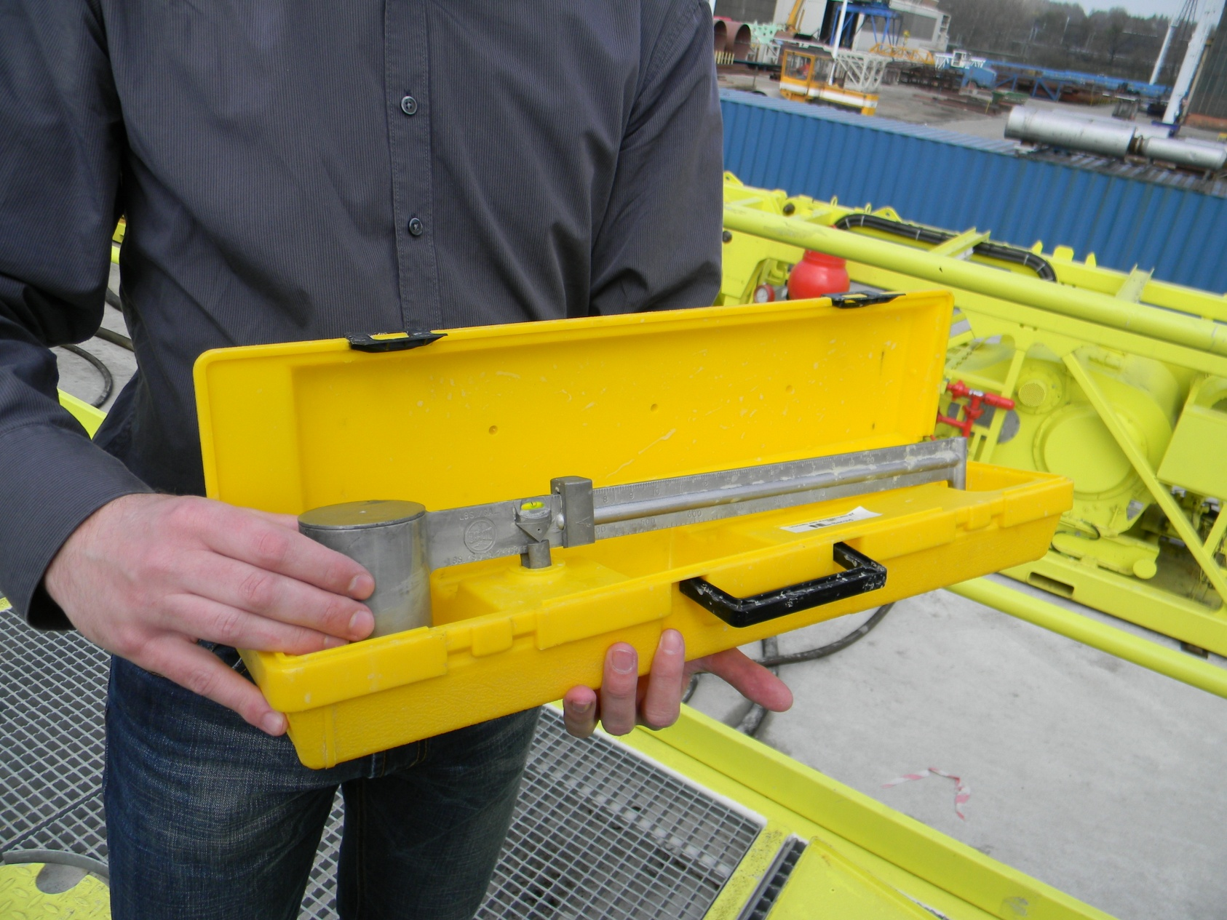
Instruments for Measuring Mud Density

Slide 23
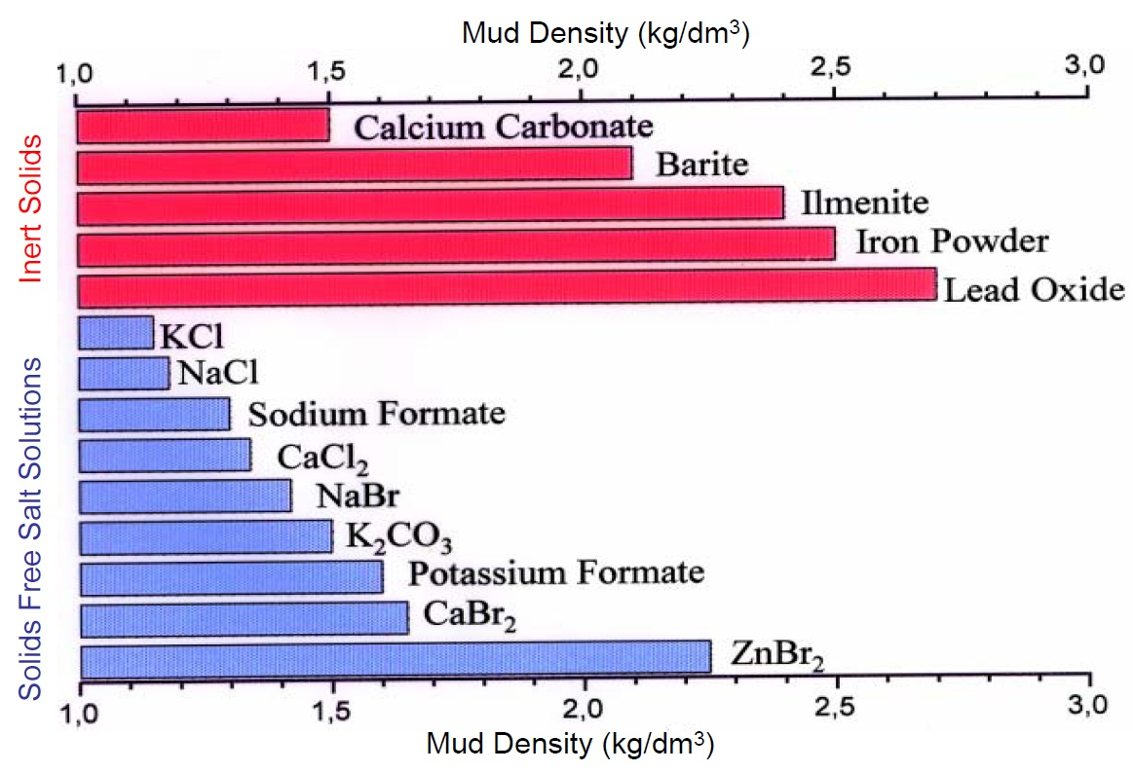
Weighting Materials for Drilling Muds

Slide 24
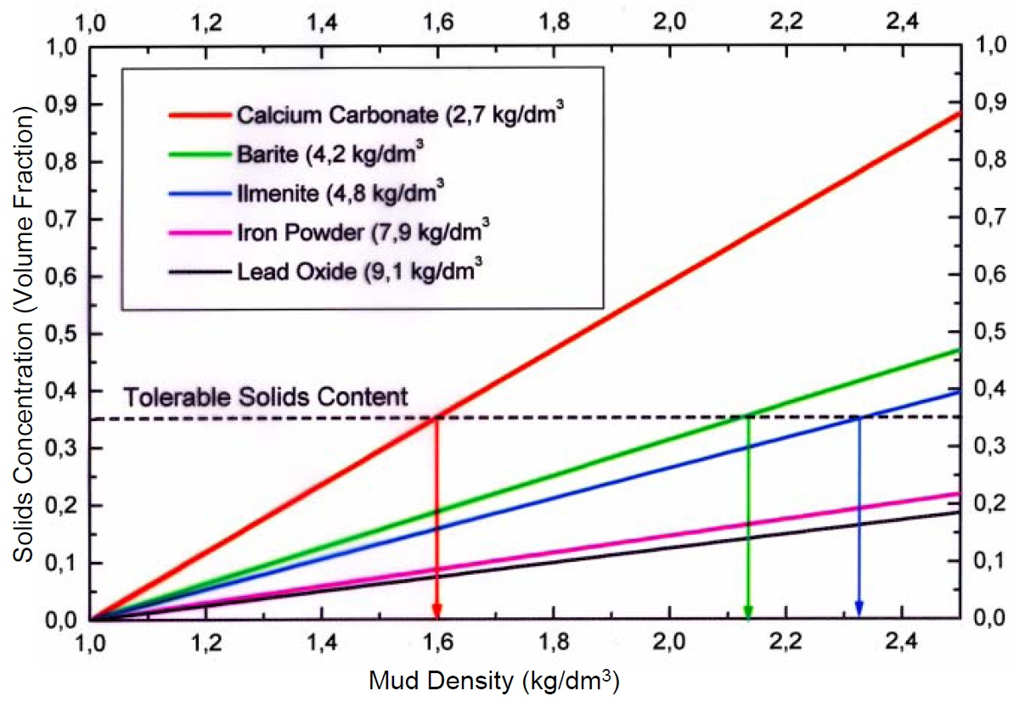
Solids Content and Mud Density for Various Weighting Materials

Slide 25
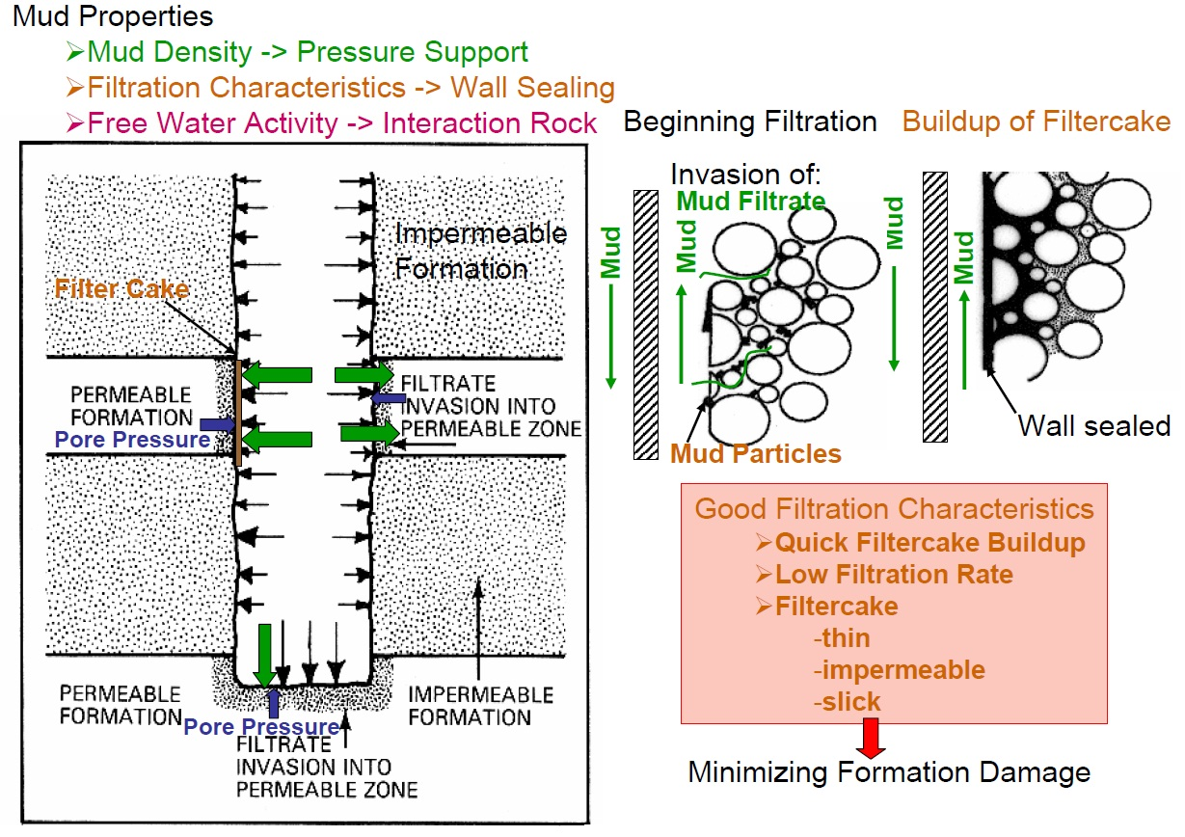
Supporting the Borehole Wall – Hydraulic Casing Effect

Slide 26
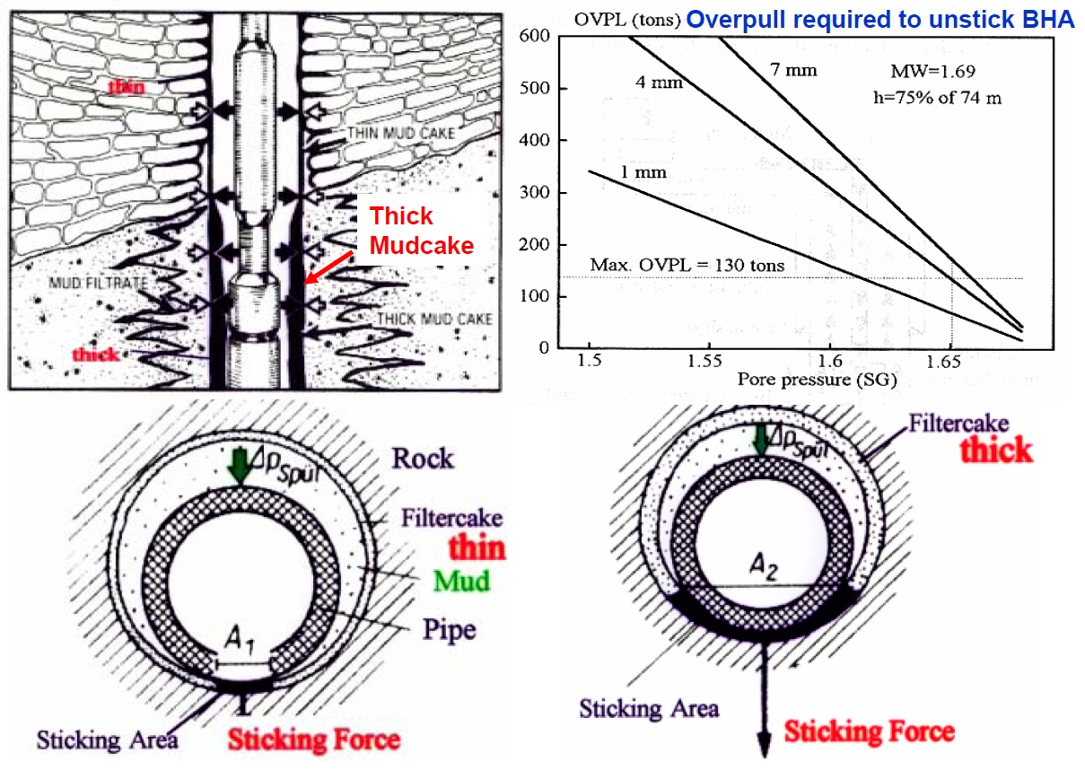
Filtercakes and Differential Sticking Mechanism

Slide 27
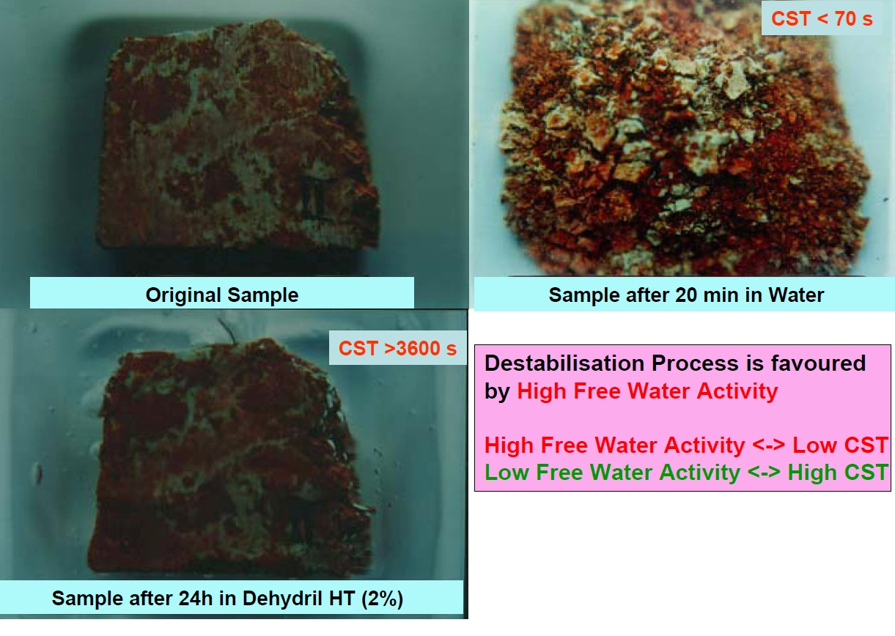
Destabilisation of Red Shale Caused by Contact with Water

Slide 28
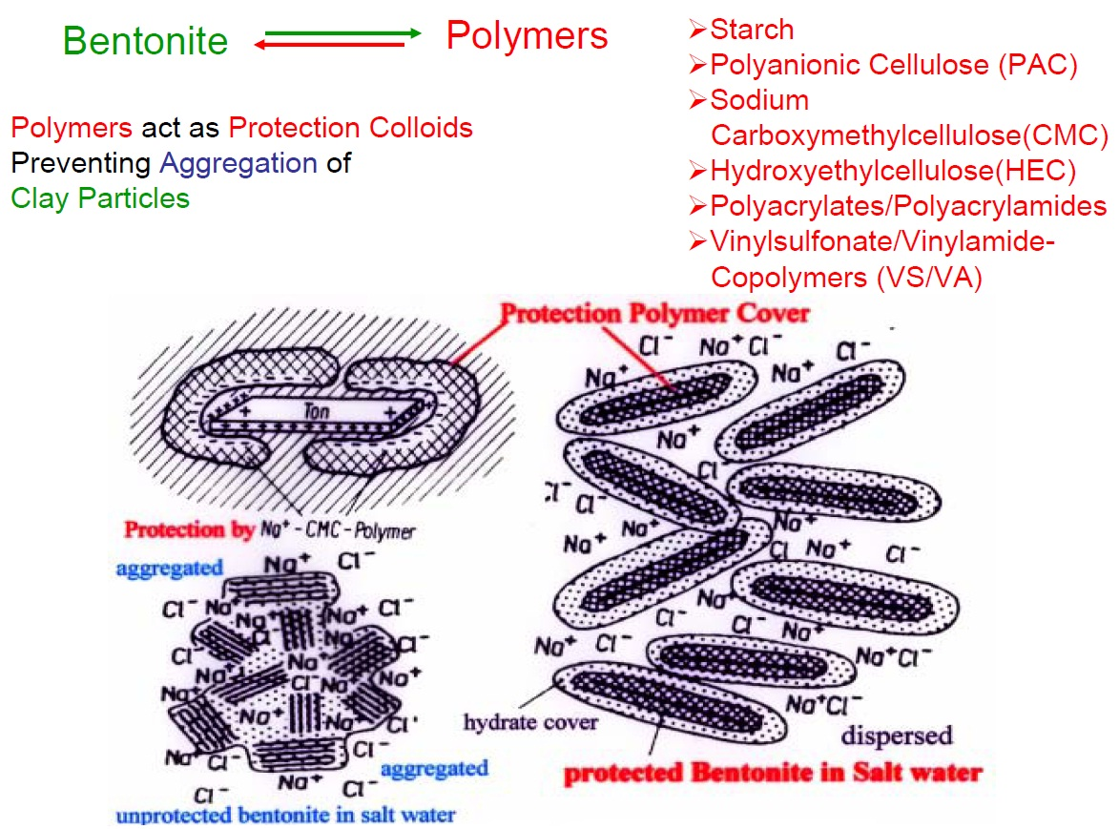
Additives Controlling Filtration Properties and Free Water Activity

Slide 29
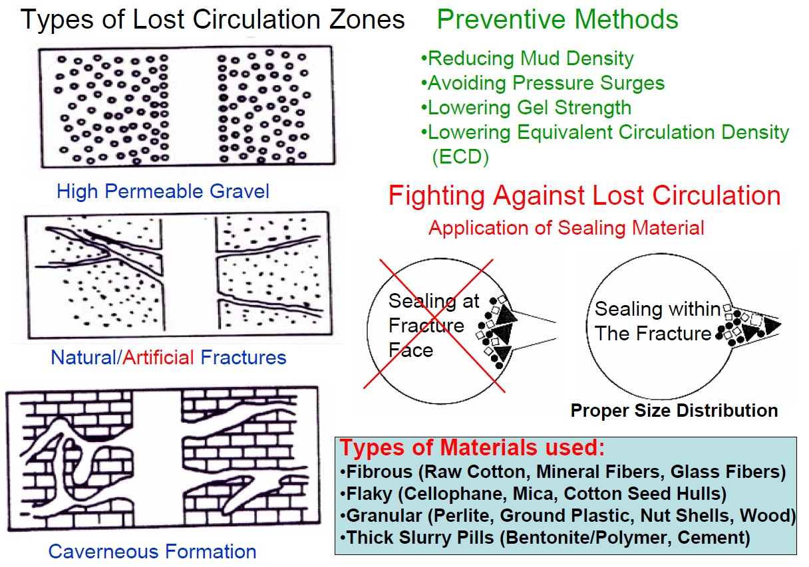
Prevention of Lost Circulation – Factors to Consider

Slide 30

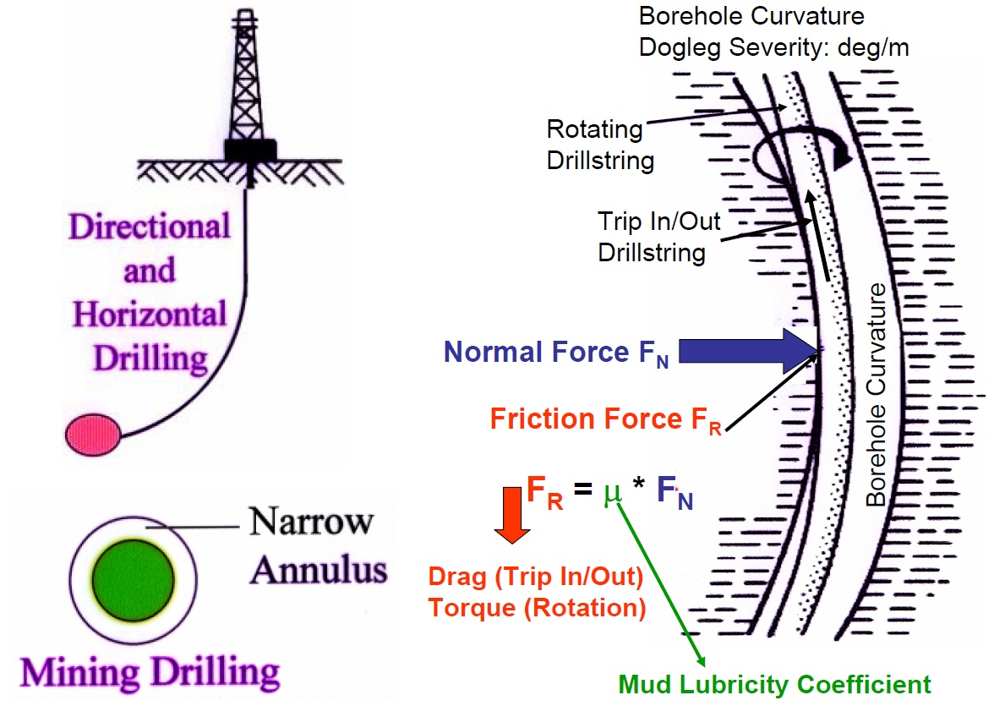
Reducing Friction – Controlling Torque / Drag

Slide 31
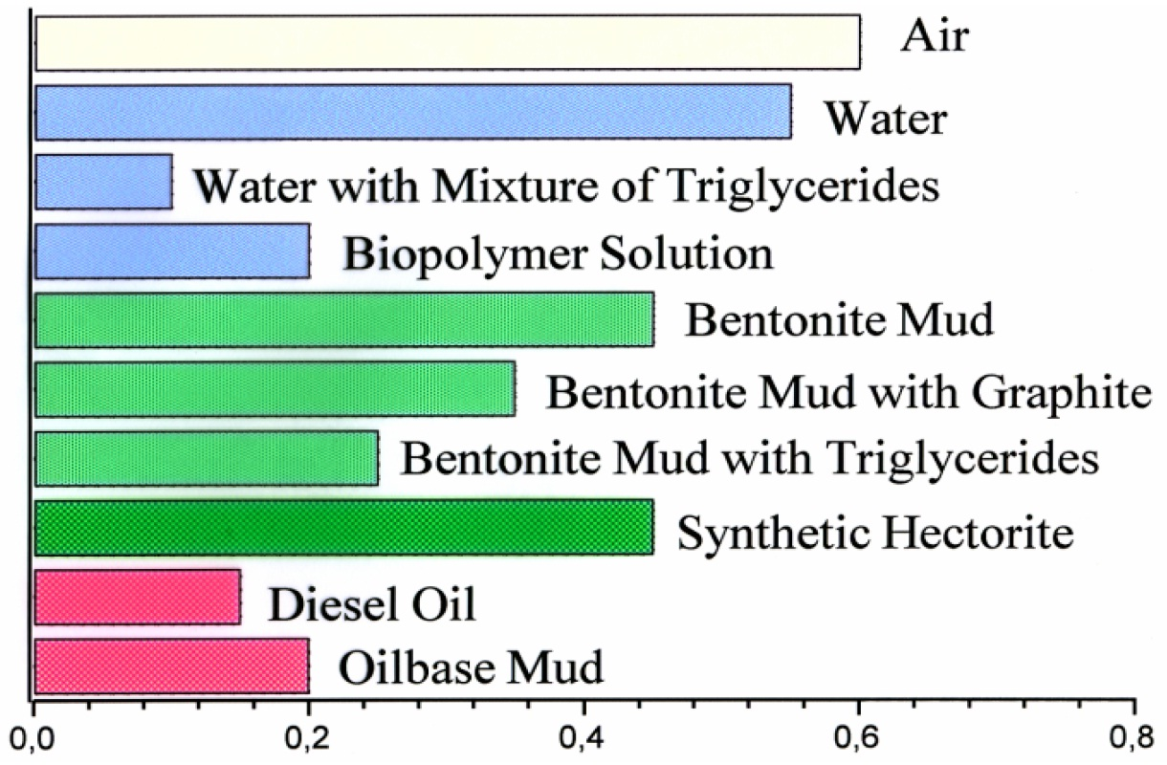
Lubricity Coefficients of Drilling Muds

Slide 32

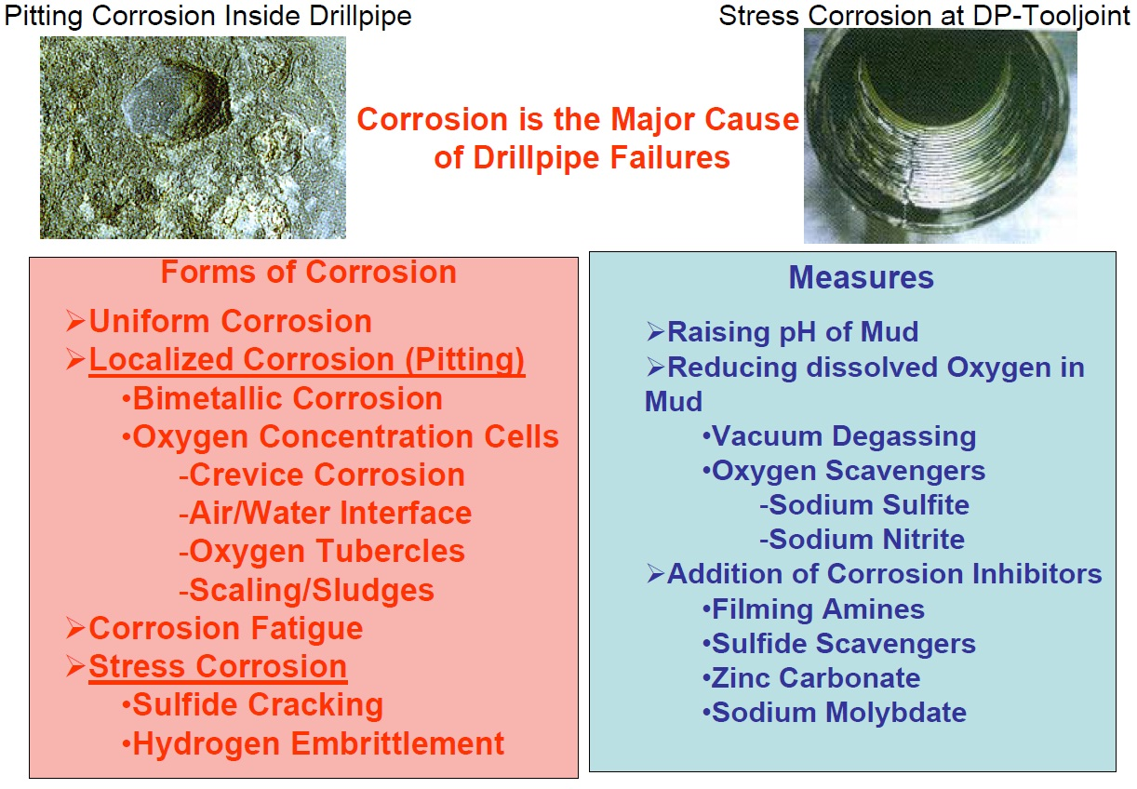
Inhibiting Corrosion

Slide 33

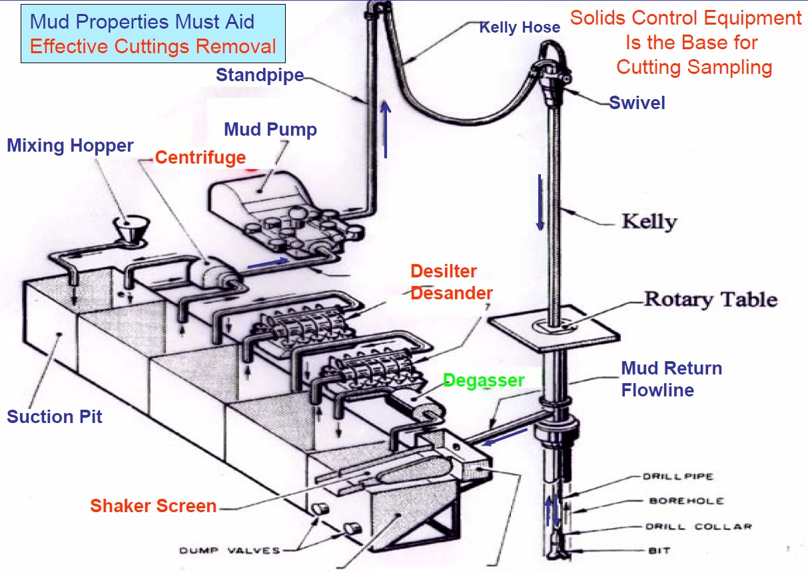
Mud Circulation System and Solids Control Equipment

Slide 34
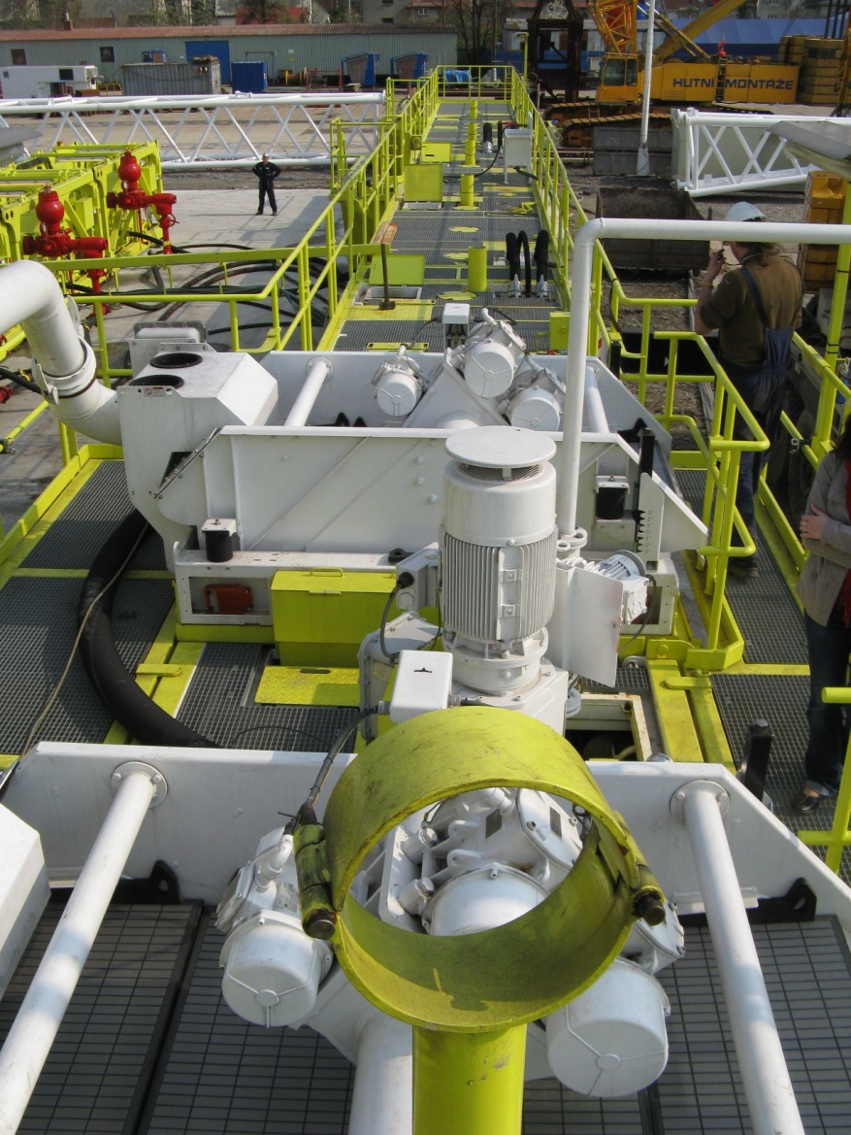
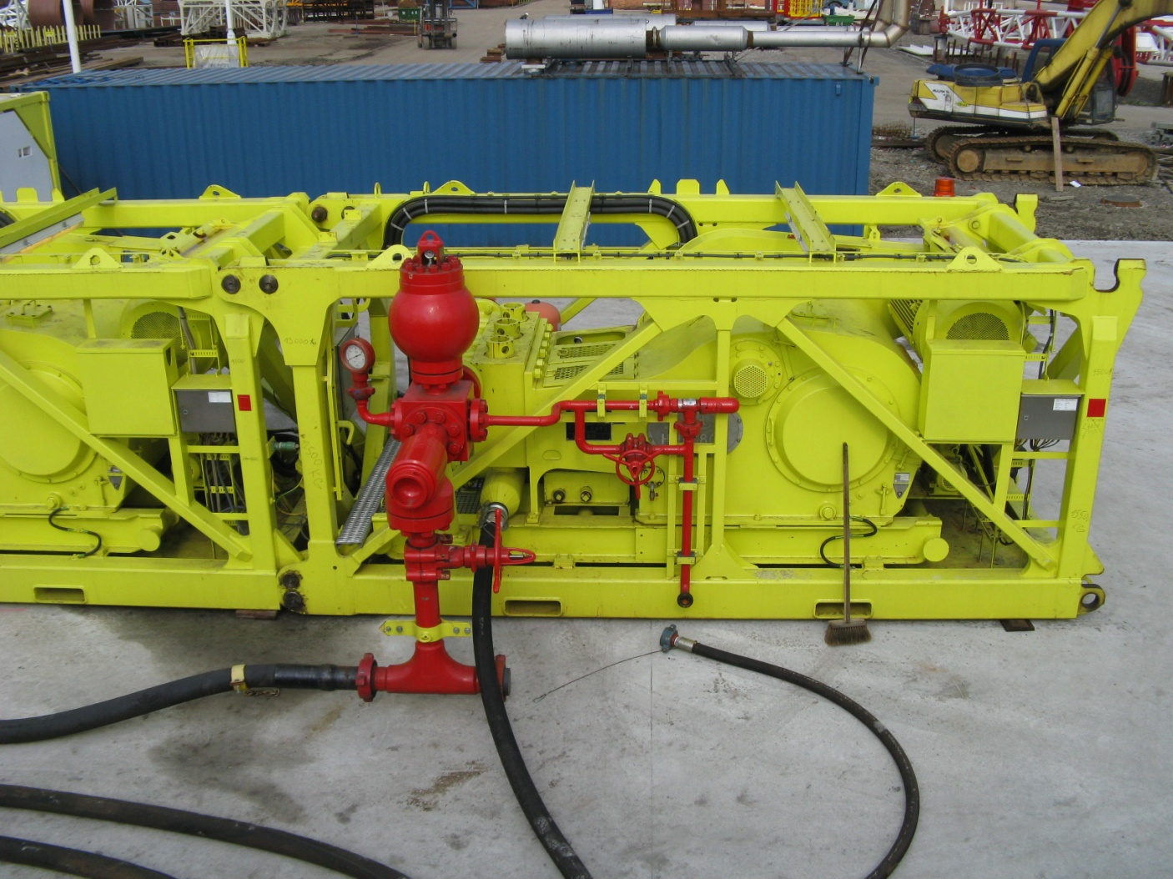
Mud Circulation System and Solids Control Equipment

Slide 35
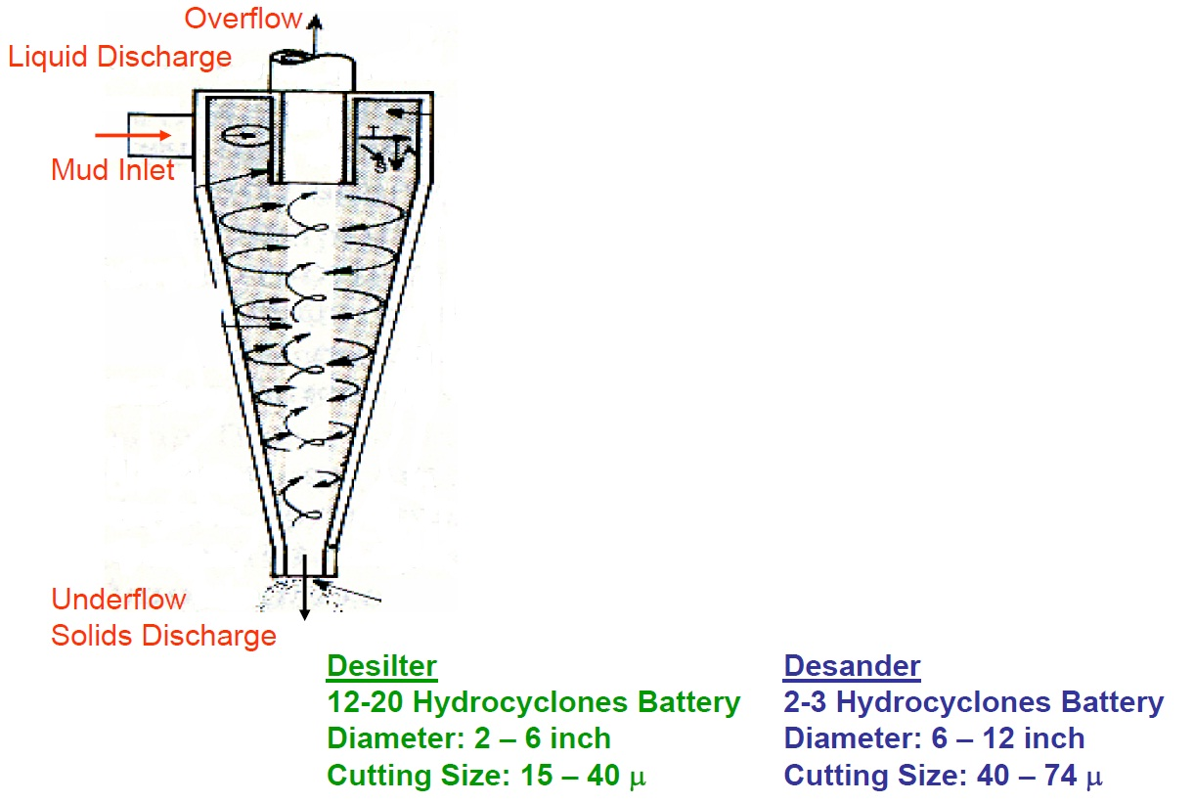
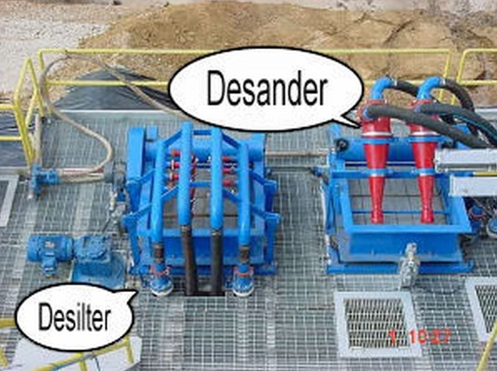
Solids Removal by Hydrocyclones

Slide 36
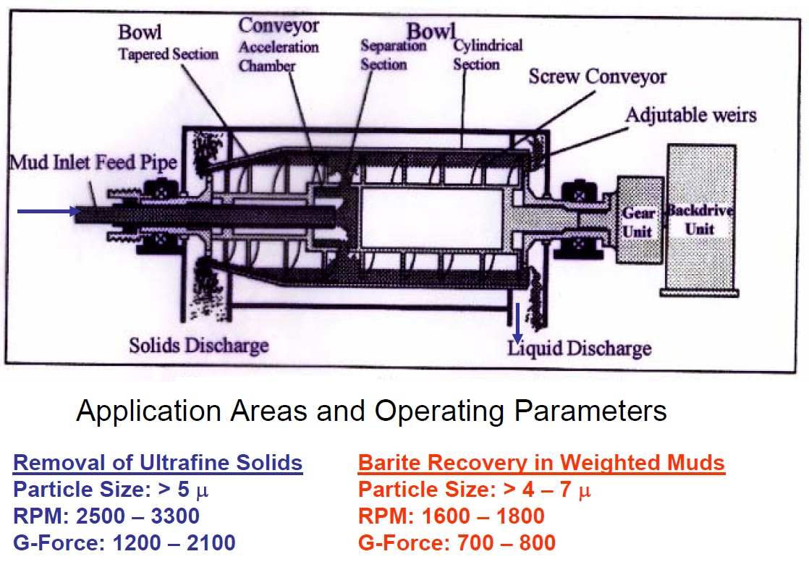
Solids Removal by Decanting Centrifuges

Slide 37
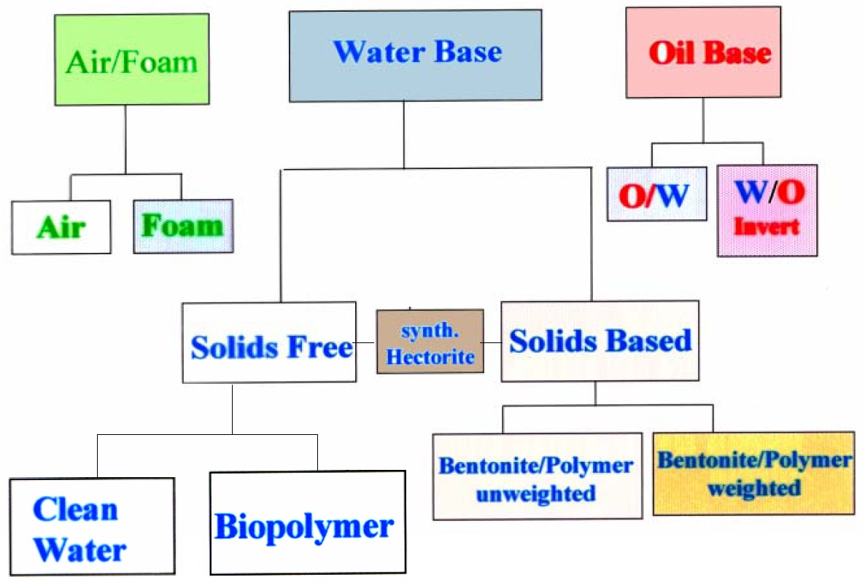
Classification of Mud Systems

Slide 38
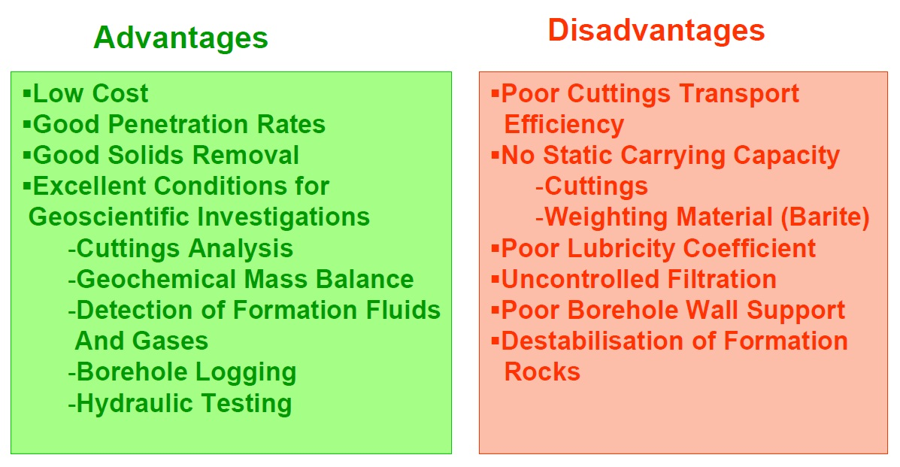
Characterization of Mud Systems – Clean Water

Slide 39
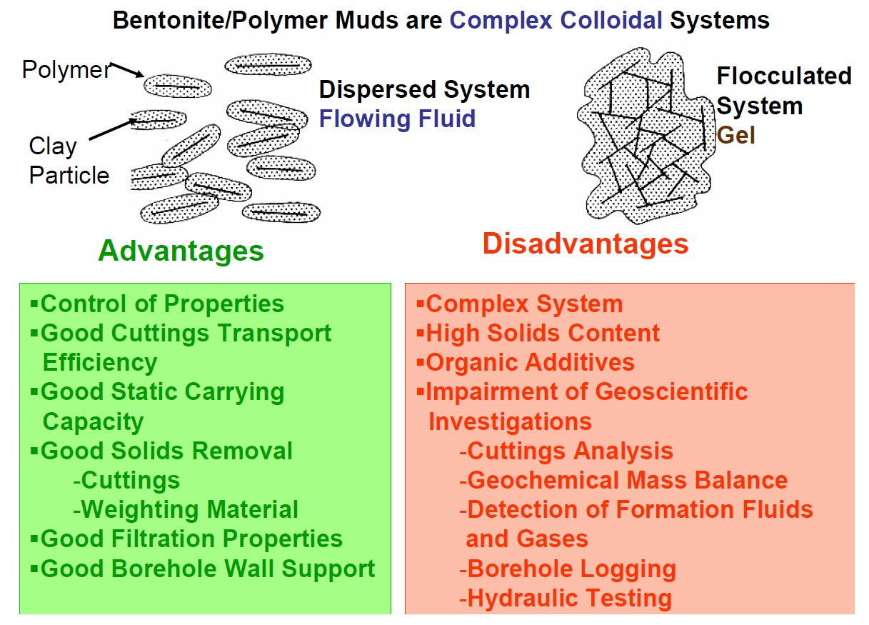
Characterization of Mud Systems – Bentonite/Polymer Muds

Slide 40
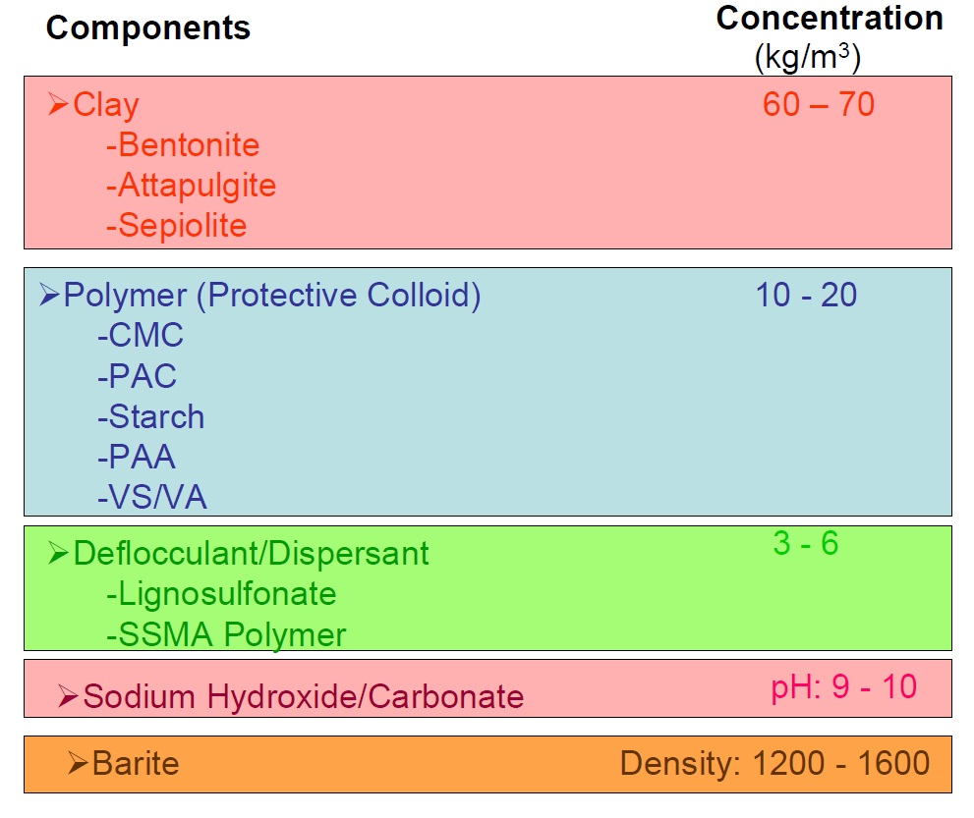
Typical Composition of Bentonit / Polymer Muds

Slide 41
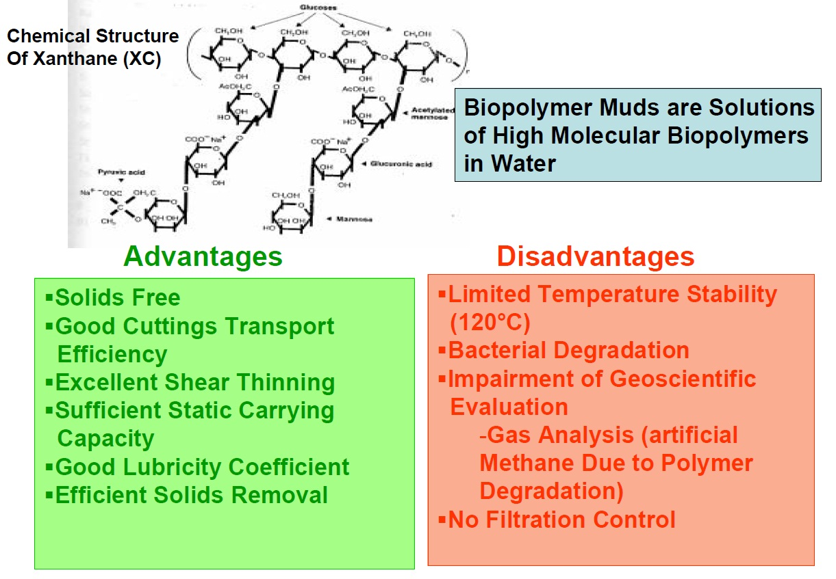
Characterisation of Mud Systems – Biopolymer Mud

Slide 42
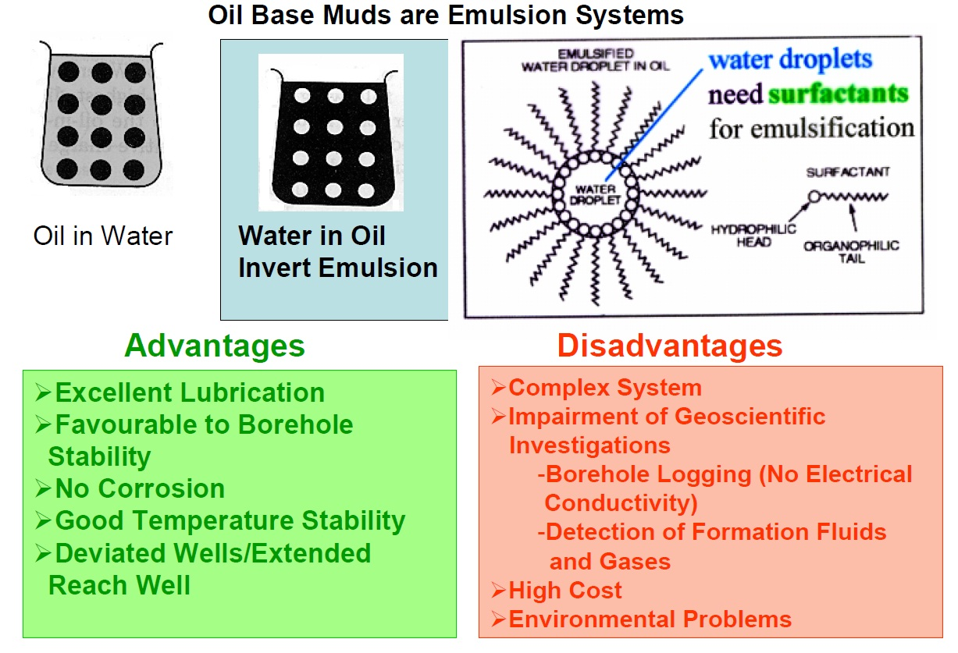
Characterisation of Mud Systems – Oil Base Muds

Slide 43
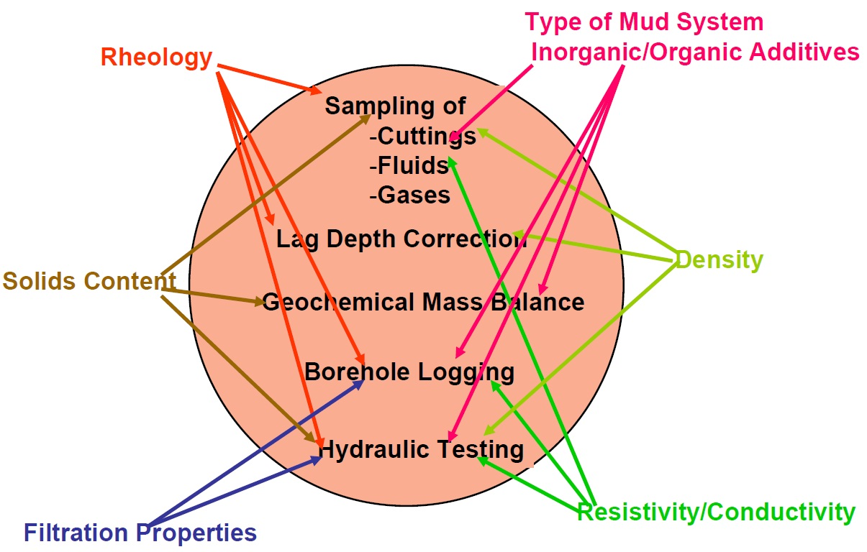
Geoscientific Objectives Influenced by Mud Properties

Slide 44

THE END!!!

Slide 45
Screwing / Unscrewing Drillpipe

